Slide 1

Understanding Dynamics
Working with people with disabilities and older adults who have experienced harm through domestic violence
This project was supported by Grant No. 2019-WE-AX-0009 awarded by the Office on Violence Against Women, U.S. Department of Justice. The opinions, findings, conclusions, and recommendations expressed in this publication/program/exhibition are those of the author(s) and do not necessarily reflect the views of the Department of Justice, Office on Violence Against Women.
Notes:
This presentation focuses on understanding more about the dynamics present when a person with a disability or older adult experiences harm in a domestic violence relationship.
Facilitator Note: If anyone attending this presentation has asked for an accommodation for low vision or is blind, then you will need to read the subtitles for the video shown in slide 3, as the video tells the story of a Deaf survivor using ASL to sign rather than voice their story.

Slide 2
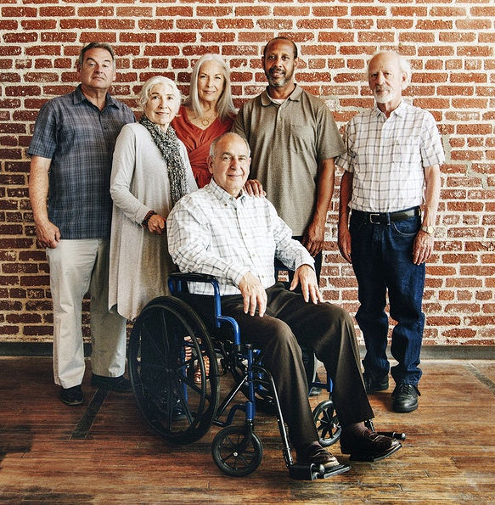
Framing the Conversation for PWDOA-who experience harm
Notes:
Facilitator can say:
This story we will be viewing in the next slide has been generously offered by this survivor to share their experiences for training purposes. It comes from the website of domestic violence agency (DeafHope) specializing in supporting Deaf people who have experienced harm. The goal is for professionals who interact with survivors with disabilities and older adults to gain increased understanding of the challenges survivors’ face, their strengths and what they encountered when attempting to access resources, including what gaps in resources they identified.
Note for Facilitator:
While presenting this video it is important to keep in mind three points:
These stories are a gift. They enable us to walk alongside the survivor and give us a window into their experiences and feelings. The Training Facilitator must create an environment that respects the survivor and centers the learning on their experiences.
These stories hold great power. As we listen, we may find the assumptions we make about people rising to the surface. The Training Facilitator can assist learners to examine these assumptions and identify where they create obstacles to a survivor-centered response.
No two stories are alike. This story can help the learner understand both small and large themes that resonate through the lives of people with disabilities and older adults and contribute to the ongoing culture of violence they experience. Assist the learner in identifying the resources and gaps faced by the survivor.

Slide 3
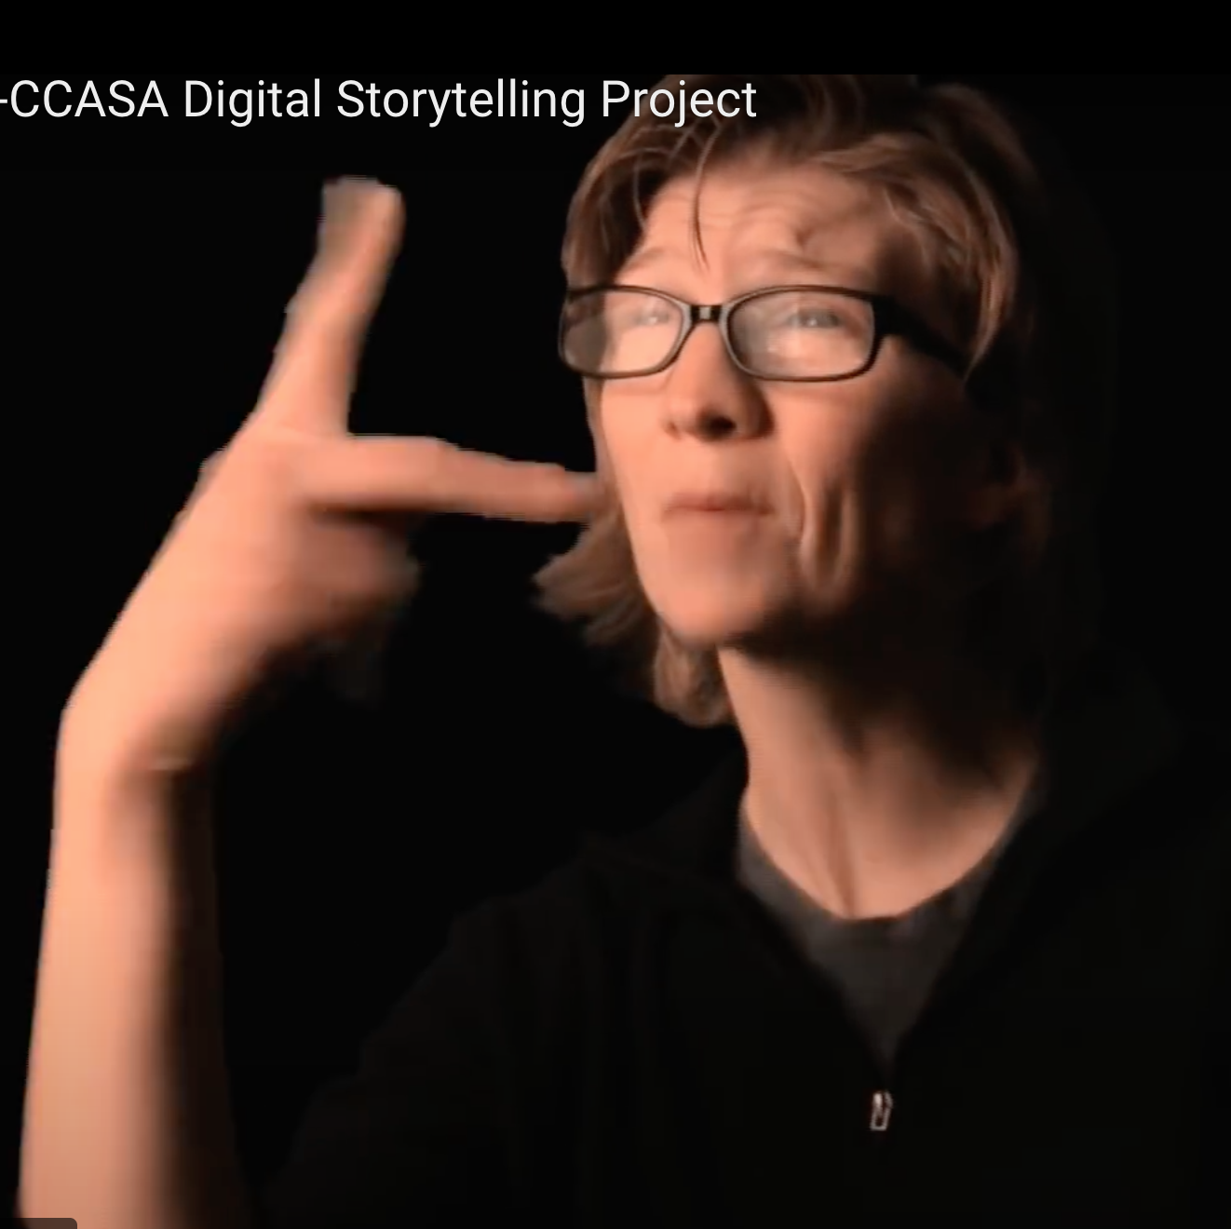
Hear my voice
DeafHope – Ruthie’s Story
  https://www.deaf-hope.org/project/ruthies-story/
Notes:
Introduce the Video (suggested language)
We are going to watch and/or listen to a recording of Ruthie. In this recording, Ruthie shares openly about their experiences with domestic violence and the challenges they faced as a Deaf survivor and older adult. If any of their examples are triggering to you based on your own lived experience, please take care of yourself and take breaks as needed.
Video run time (3 minutes, 46 seconds)
*Facilitator Note: be prepared to read the subtitles for anyone attending the training who has low vision or is blind.

Slide 4
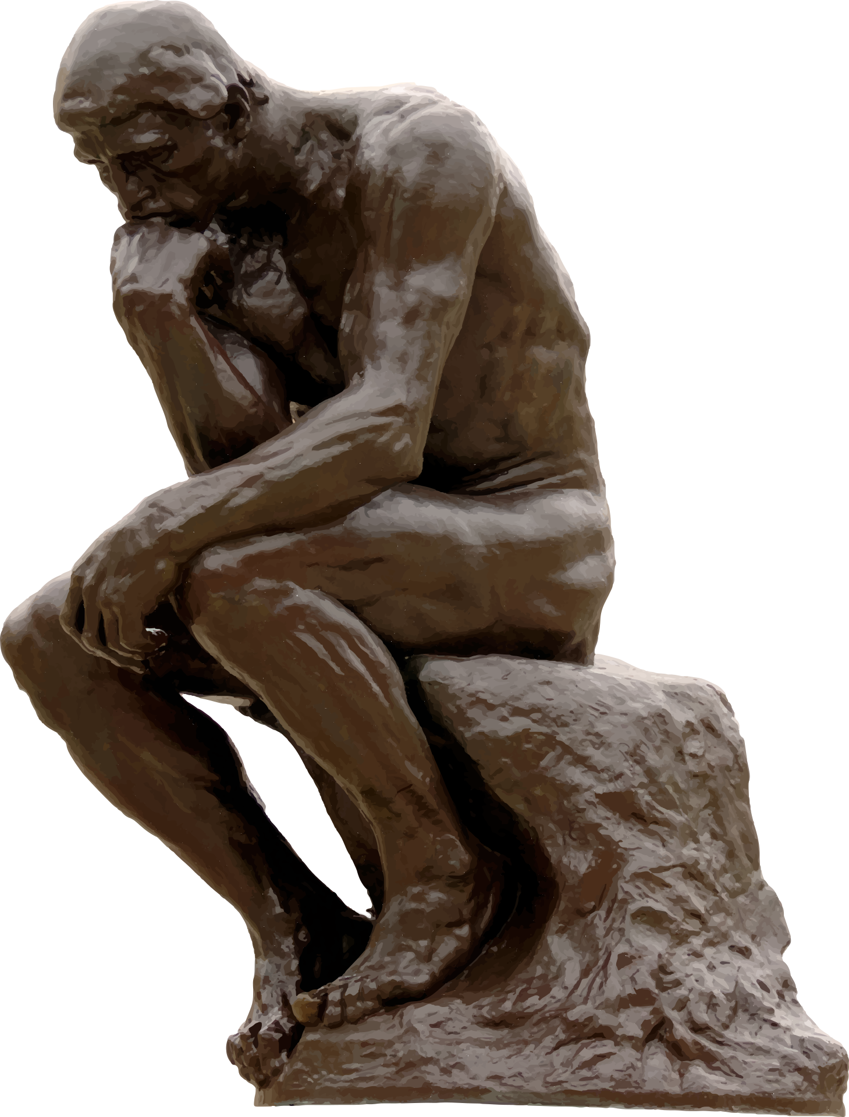
What did we just learn?
Reflect
Learn
Respond
Notes:
After the Video ---------
Introduce the Learning Objectives for this Training
Say: During this training we will be following these learning objectives to gain a better understanding of the dynamics involved when a person with a disability or older adult experiences harm from a domestic violence relationship.
Reflect on the opportunities and challenges of responding to PWDOA who experience harm.
Learn about specific dynamics that impact the ways PWDOA may respond when confronted by persons who harm and by those who are in positions of power.
Develop specific strategies to respond to PWDOA who have experienced harm in ways that support trauma-informed care.
Facilitator Note: See next slide for discussion questions regarding learning objective 1: Reflect

Slide 5

Reflect
Pair and Share
Notes:
Facilitator Note: (in person trainings)
Write the Reflection questions on a whiteboard or use a handout with the questions. Have participants pair up to talk through each question. Facilitator can bring the group back together to talk about the last 2 questions as a large group.
ALTERNATE FORMAT: If doing this training virtually, have each person take a few minutes to jot down their thoughts about each question, using the handout. Then, using breakout rooms, divide them into small groups of 3 or 4 max to discuss the last 2 questions.
Questions:
- What stood out for you from this video?
- Have you ever worked with a someone like this before?
- How would you rate your confidence in being able to respond to a survivor like this?
- What assumptions did you find yourself making?
- What do you think you would need to help this survivor?

Slide 6
Additional resource links to Ruthie’s Story
Ruthie now:
https://www.rit.edu/ntid/50reunion/entertainment/ruthie-jordan
Ruthie’s work with the Colorado Coalition Against Sexual Assault
https://www.ccasa.org/programs/special-projects/digitalstorytelling/
Article about her testimony for Jini Barnum:
https://www.courant.com/news/connecticut/hc-middletown-garofalo-sentencing-20150616-story.html
Notes:
Optional if audience would like more resource information

Slide 7
What do we mean by “Disability”?
Disabilities can be visual, auditory, physical, communicative, developmental or emotional. Some individuals have a combination of disabilities.
Not all disabilities can be seen.
The Americans Disabilities Act (ADA) covers more than 900 different disabilities.
DISability Inability.
Notes:
Facilitator Note:
Read slide content. Can add the following quote for emphasis.
“Disabilities, and perhaps more importantly peoples’ reactions to disabilities, create barriers for people with disabilities through stereotypes, myths, prejudices, fears and ignorance.” (‘People First’), LE, p. 51, Prosecutors, p. 74)
Facilitator Notes: See Protocol, LE and Prosecutor, Definitions, pp. 13-14 (LE); p. 14 (Prosecutors)
Also see handout on People First, Protocol for LE, section 5, p; 50 – 51; Protocol for Prosecutors, section 3, p. 74
For additional context and information.
PEOPLE WITH DISABILITIES ARE PEOPLE FIRST (Optional handout available or optional to add to presentation)
• Disabilities can be visual, auditory, physical, communicative, developmental or emotional. Some individuals have a combination of disabilities.
• People with disabilities are a part of a group that cut across racial, ethnic, religious, economic and social lines.
• Disabilities affect a wide range of activities—from small to great. • Your neighbor, loved one or even you may have a disability.
• Disabilities are not contagious.
• Miracles may sometimes happen, but people with disabilities are not usually waiting for them.
• Not all disabilities can be seen.
• People with disabilities know they have a disability, and tend to know that you know.
• People with disabilities prefer to emphasize what they can do rather than what they cannot.
• Disability is not the sum of an individual's life, any more than having a certain hair color is the sum of your life.
• People with disabilities can and do engage in sex and have intimate relationships.
DISability is not Inability

Slide 8
What do we mean by “Older Adult”?
As defined in Illinois Compiled Statutes, an elderly person means a person 60 years of age or older. Although older adult is the preferred term for someone 60 and older in Illinois, statutory definitions use the term elderly person.
More than one in every seven Americans is over age 65. (2020 data) This number is expected to grow.
Notes:
Facilitator Note:
Read slide content.
Say: These two slides help ground us in the definitions of who we are referring to when we say people with disabilities and older adults. I think it is important for us to understand that we are talking about a fairly large group of people, some of whom we might easily recognize as belonging to these groups and some who are not so easily identified as a person with a disability or older adult.
Facilitator Note: More information can be found in Protocol, LE and Prosecutor, Definitions, pp. 13-14 (LE); p. 14 (Prosecutors)

Slide 9
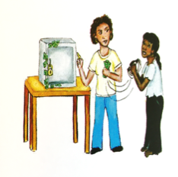
Culture of Compliance
How Power is used in relationships creates a culture of compliance for people with disabilities and older adults.
It is a survival strategy!
Notes:
SAY:
It is important that law enforcement [and prosecutors] understand that some individuals with disabilities have been trained to be acquiescent and compliant. Because of possible past abuse and encounters with people who hold societal misperceptions, individuals with disabilities may have a long history of “getting in trouble” if they do not do what a person in authority tells them to do. For people with intellectual and developmental disabilities, this compliance can extend throughout their lives. A culture of compliance can promote a culture of crime and result in multiple incidences of victimization with multiple perpetrators. Victims with disabilities may not report the violence or may not perceive the experience as criminal, as they have been taught that staff or others in authority can say or do what they want. Individuals with disabilities often experience relationships as someone having power over them.
ASK: Does this apply to older adults, too?
It is important for law enforcement to recognize when someone appears to be overly concerned about saying or doing the “right” thing. If the victim looks at a support person before answering questions posed by law enforcement during an interaction or interview, this may be an indicator of compliance and dependence. Or if the support person tends to finish the sentences or interrupt the individual with a disability or older adult when they are speaking.
Facilitator Note:
SOURCE: Definition of Culture of Compliance – see LE Protocol, sec. 6, p. 225
TIPS FOR FACILITATORS: Provide examples
Tie it back to the survivor story
Recognize that the survivor is using an adaptive response to the way power is used by the person causing harm
The survivor has learned through repeated reinforcement that speaking up doesn’t work and the person causing harm has sought to make the survivor question their own voice and reasoning, so that they can maintain power.
How might the survivor respond to LE or Court personnel from the context of a Culture of Compliance?

Slide 10
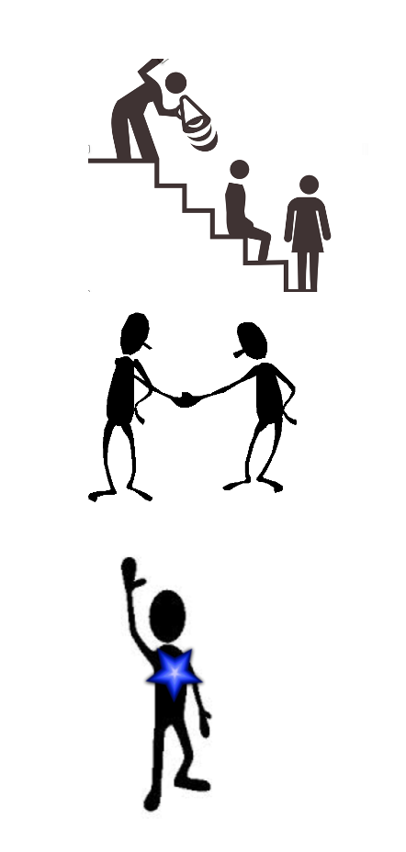
Role of Power in Relationships
Power Over
Shared Power
Power
Inside
Notes:
Talk about the role of power in relationships. See handout or part of handout from Envision Illinois on Types of Power in Relationships.
This can give information to the Facilitator to lead this part of the presentation. It can also be used as optional activity
SAY:
When we think about how power is used in relationships, we need to consider the power dynamics: Power over, power with or shared power, and the power inside.
Power over – once a person takes more power over another person, that is when abuse is more likely to occur. It is important to remember, it is possible to have authority over another person without abusing that position of power. Provide examples from the handout of how Power Over another can be used to cause harm.
Power with or Shared Power can be found in healthy relationships. It is typically shown by shared decision-making, respect for others’ feelings and values, opportunities to make choices for oneself and have those choices respected, having the support to be and do one’s best.
The Power Inside means people are recognized and expressing their own power. They can speak up for their rights. They can make choices based on what they believe, and they can seek out the information and support they need.

Slide 11
Ableism
Ableism is a set of beliefs or practices that devalue and discriminate against people with physical, intellectual, or psychiatric disabilities and often rests on the assumption that disabled people need to be ‘fixed’ in one form or the other.
(Center for Disability Rights)
Notes:
Definition on the slide comes from this website: https://cdrnys.org/blog/uncategorized/ableism/
Create audio file of self-advocates reading quotes of examples of ableism. Facilitator can play the audio file here.
Introduce concept of Historical trauma (see LE protocol, Sec. 3, p. 26) Examples of eugenics, forced sterilization, putting people in institutions.
Use Audio File here on Ableism
More material available in protocols
Sec 6, pp. 62 – 63 Top 10 Things Law Enforcement Needs to Know; pp. 64 – 65 Feedback from Older Adults in Illinois
Check your assumptions
Objectifying is a way to “other” PWD and not see them as fully human.
Yet this plays into how PWD are victims of domestic and sexual violence at higher rates

Slide 12
Ageism
Ageism refers to the stereotypes (how we think), prejudice (how we feel) and discrimination (how we act) towards others or oneself based on age.
Half the world’s population is ageist against older people.
        (World Health Organization, 2021)
Notes:
https://www.who.int/news-room/questions-and-answers/item/ageing-ageism
Assumptions we make about older adults
Internalized oppression is cultural conditioning. Believing the cultural messaging around “I no longer have value. I’m useless. I’m a burden.”
This type of thinking creates a view of “It’s us and the others”
Even attitudes like “Respect your elders” can be a form of objectifying and separating older adults from us (othering), not seeing them as equals to us.
How do these attitudes play into how older adults are victims of domestic and sexual violence at higher rates?
For additional information, see: National Clearinghouse on Abuse in Later Life – Combating Ageism is Combating Abuse
https://www.ncall.us/2021/05/25/combating_ageism_abuse/

Slide 13

Ableism and Ageism
Ableism and Ageism create barriers that separate us from people with disabilities, Deaf people and older adults.
Notes:
Protocol for LE, section 8, p. 173 Barriers for Older Adults and PWD
Read slide. It also contributes to how we perceive PWD and older adults
Talk about visual. Who can see over the wall? The wall can be a metaphor for the barriers people with disabilities and older adults face in accessing supports and justice. A consequence of Ableism and Ageism is accessibility obstacles. There are many barriers for PWD and Older Adults in accessing support, services and justice.
Choices are more limited for PWD and older adults. Those who can more easily ”see over the wall” sometimes don’t realize the impact of these barriers. Or don’t know how to break down the barriers so that rights and access are ensured.

Slide 14
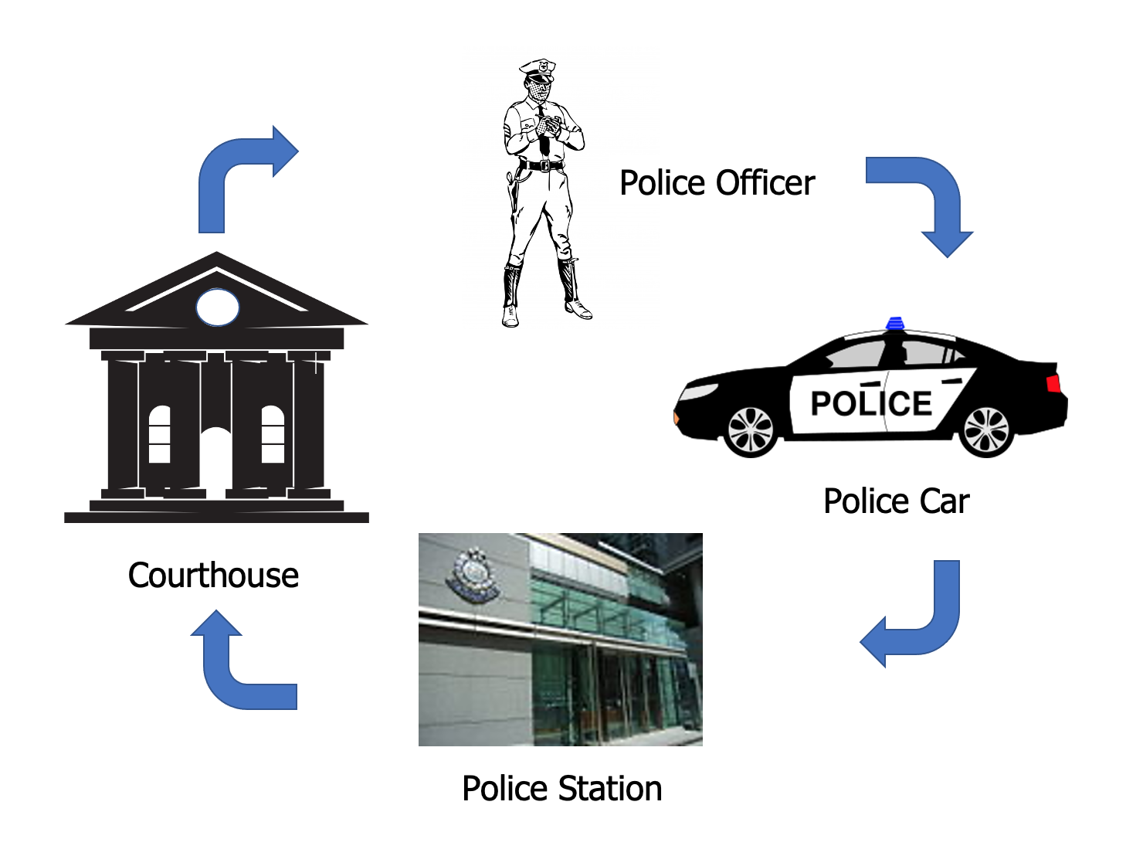
Accessibility Obstacles - Activity
Notes:
Introduce Activity
On the slide we can see a series of images –
Initial interaction with Law Enforcement
Patrol car
Police station
Courthouse
We will be moving into small groups to do this activity, which involves reading a case scenario and then answering questions. In the small group, they will think about the case scenario and the experience of the person with a disability and older adult. Each small group will identify potential obstacles the person could face and what options could assist the person to have a more successful experience in that setting.
Facilitator Note: Ask for each group to identify a member who will report back on their discussion to the larger group.

Slide 15

Check your assumptions
Ethical dilemma: Balancing the need to respond quickly and ensure safety with offering choices and self-determination
Notes:
Can either stay in small groups for this discussion or come back to the large group.
ASK: What are people’s thoughts about balancing the need to respond quickly to ensure safety with the need to offer choices and allow time for self-determination?
Use material from their small group discussion to continue this conversation. If necessary, provide additional examples to further prompt this discussion:
Waiting for a sign language interpreter
Deciding how to deal with survivor’s service animal
Figuring out how to notify the legal guardian and navigate if the guardian objects to the survivor’s choices (i.e., seeking services from a DV agency)

Slide 16

Respond – Power in Relationships
  Acknowledge the power in your role and who you represent
  Give power back when you can
    Active listening and respect
    Collaborate on safety planning
    Offer choices
Notes:
Facilitator Note:
Facilitator can read the points made on this slide (#1. and 2). Talk about the importance of acknowledging the power the helper’s role holds, and that their organization holds power, too. Law enforcement, court personnel and first responders can talk to a survivor about how they can collaborate in decision-making and offer choices. It is also helpful to explain how the process works and what are the steps the LE, prosecutor or other responder may need to follow in fulfilling their role. Ask for any examples a participant can share where they have tried these strategies. How did it go? How did the survivor respond? How did it help the legal process and outcome?
These two slides (#15 and 16) are important opportunities for the Facilitator to draw together the learning themes: Power in Relationships and Ableism and Ageism and emphasize the ways participants can change the dynamics in their interactions to better support survivors. The Facilitator can draw from the discussions held during the previous activities. Point to the resources found in the Protocols listed here.
LE protocol, sec 3, p. 24 – 25
Also, the section on “Collaborate on Safety planning”, LE Protocol, sec. 7, pp. 166 - 167

Slide 17
Respond - Challenge the “ism”
Believe that the person with a disability and older adult is the expert on what they need
Establish a communication plan, including accessible formats for any materials or procedures
Engage people to participate in making decisions
Notes:
Facilitator Notes:
This slide and the previous (#15) are important opportunities for the Facilitator to draw together the learning themes: Power in Relationships and Ableism and Ageism and emphasize the ways participants can change the dynamics in their interactions to better support survivors. Because these “isms” are often based in our attitudes and assumptions, just taking steps like believing a person knows what they need, listening to them when they identify supports that would be helpful and collaborating on decisions can make a profound difference!
Ask: What are some ways participants have seen this in action? How has this training helped them become more aware of how ableism and ageism impact the views and actions we and others take regarding people with disabilities and older adults?
The Facilitator can draw from the discussions held during the previous activities. Point to the resources found in the Protocols listed here.
Accessibility Review Tool, LE Protocol, sec. 9, pp. 182 - 188
Also, see: “Promote Survivor-driven decision-making” (Protocol for Prosecutors, Section 2, Model Response, p. 20)
Check for understanding
Assess if someone is influencing their decisions
Provide enough time for decision-making

Slide 18

Respond - Take one step
Notes:
Facilitator Note:
Summarize the Learning Objectives from slide #4: Reflect, Learn and Respond. Give examples from the discussions and the activities.
SAY: As we finish up today, let’s think about our response. Who is willing to say one step they plan to take after attending today’s training?
Say it out loud
Write it down
And Do it!

Slide 19
Resources
Illinois Family Violence Coordinating Councils Model Protocols on Responding to People with Disabilities and Older Adults
http://www.icjia.org/ifvcc/projects
National Clearinghouse on Abuse in Later Life – Combating Ageism is Combating Abuse
https://www.ncall.us/2021/05/25/combating_ageism_abuse/
World Health Organization Global Report on Ageism: Executive Summary
https://www.who.int/publications/i/item/9789240020504
United Nations Access to Justice: Rights of People with Disabilities
https://www.ohchr.org/Documents/Issues/Disability/SR_Disability/GoodPractices/Access-to-Justice-easy-en.pdf
Notes:
Protocol
NCALL
World Health
UN

