Slide 1

Partners for a Trauma-Informed Response
Working with people with disabilities and older adults who have experienced harm through domestic violence
This project was supported by Grant No. 2019-WE-AX-0009 awarded by the Office on Violence Against Women, U.S. Department of Justice. The opinions, findings, conclusions, and recommendations expressed in this publication/program/exhibition are those of the author(s) and do not necessarily reflect the views of the Department of Justice, Office on Violence Against Women.
Notes:
Facilitator Note:
Introduction to topic.
Say: “This is the third in a three-part series on Working with people with disabilities and older adults who have experienced harm through domestic violence. The first part is on Understanding the Dynamics of domestic violence as it impacts people with disabilities and older adults. The second part is focused on Communication Strategies to better support your interactions with older adults and people with disabilities. This third part is focused on Resources in your Community and how to form working partnerships to better serve people with disabilities and older adults who have been harmed through domestic violence.”

Slide 2
Learning Objectives
Participants will be able to identify how a trauma-informed approach can impact the coordination of services and supports in responding to domestic violence.
Participants will form a plan of action for establishing or strengthening their relationship with local community partners to better serve those impacted by domestic violence.
Notes:
Facilitator Note:
Read slide content.

Slide 3
What do we mean by “Disability”?
Disabilities can be visual, auditory, physical, communicative, developmental or emotional. Some individuals have a combination of disabilities.
Not all disabilities can be seen.
The Americans Disabilities Act (ADA) covers more than 900 different disabilities.
DISability Inability
Notes:
Facilitator Note:
Read slide content. Can add the following quote for emphasis.
“Disabilities, and perhaps more importantly peoples’ reactions to disabilities, create barriers for people with disabilities through stereotypes, myths, prejudices, fears and ignorance.” (‘People First’), LE, p. 51, Prosecutors, p. 74)
See Protocol, LE and Prosecutor, Definitions, pp. 13-14 (LE); p. 14 (Prosecutors)
Also see handout on People First, Protocol for LE, section 5, p; 50 – 51; Protocol for Prosecutors, section 3, p. 74
For additional context and information.

Slide 4
What do we mean by “Older Adult”?
As defined in Illinois Compiled Statutes, an elderly person means a person 60 years of age or older. Although older adult is the preferred term for someone 60 and older in Illinois, statutory definitions use the term elderly person.
More than one in every seven Americans is over age 65. (2020 data) This number is expected to grow.
Notes:
Facilitator Note:
Read slide content.
Say: These two slides help ground us in the definitions of who we are referring to when we say people with disabilities and older adults. I think it is important for us to understand that we are talking about a fairly large group of people, some of whom we might easily recognize as belonging to these groups and some who are not so easily identified as a person with a disability or older adult.
Facilitator Note: More information can be found in Protocol, LE and Prosecutor, Definitions, pp. 13-14 (LE); p. 14 (Prosecutors)

Slide 5
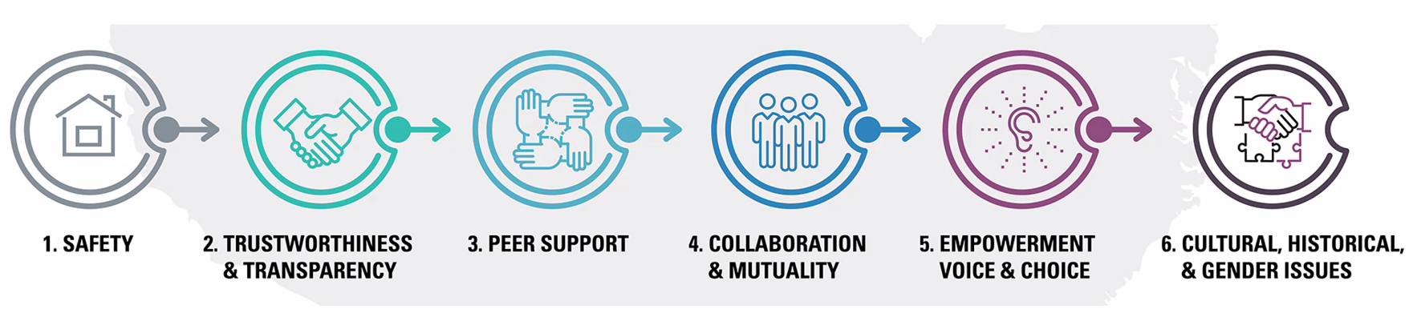
Core Principles of a Trauma-Informed Approach
Trauma Informed Practice is a strengths-based framework founded on six core principles.
- Concept of Trauma and Guidance for a
Trauma-informed Approach, SAMHSA, 2014
Notes:
Facilitator Note:
Say: “The Substance Abuse and Mental Health Services Administration developed these six core principles for a trauma-informed approach. They fit in well with the goals of first responders, law enforcement and prosecutors who respond to domestic violence situations. Let’s do a quick review:
Safety - Understanding safety as defined by those served is a high priority.
Trustworthiness and Transparency – Operations and decisions are made with transparency with the goal of building and maintaining trust with survivors and families as well as community partners
Peer Support – Peer support and mutual self-help are key vehicles for establishing safety and hope, building trust and enhancing collaboration. The stories and perspectives of those who have lived experiences of trauma can promote recovery and healing.
Collaboration and Mutuality – Partnering, sharing power and decision-making helps to demonstrate that healing happens in relationships.
Empowerment, Voice and Choice – Organizations understand the importance of power differentials and the ways in which survivors have been diminished in voice and choice. Individuals’ strengths and experiences are recognized and built upon. They are encouraged to build on their self-advocacy skills.
Cultural, Historical and Gender Issues – To actively move past cultural stereotypes and biases, regarding disability and aging and across all the intersections of race, religion, ethnicity, gender identity and sexual orientation creates a new way of operating and all involved benefit.
REMEMBER: Trauma-informed practice is a strengths-based framework!”
Source: SAMSHA’s Concept of Trauma and Guidance for a Trauma-Informed Approach, 2014
https://ncsacw.acf.hhs.gov/userfiles/files/SAMHSA_Trauma.pdf

Slide 6
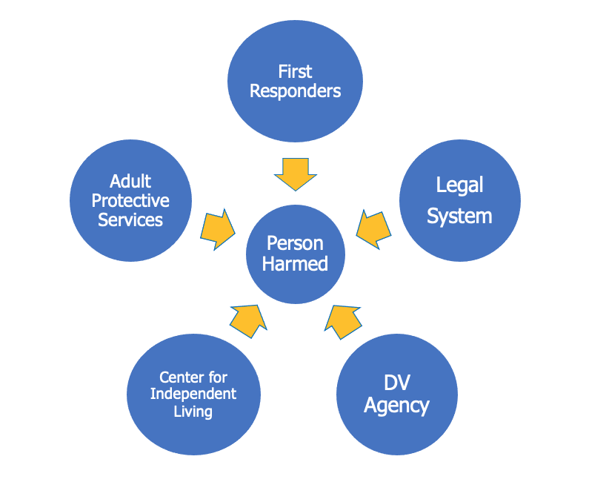
How we typically operate
Notes:
Facilitator Note:
Say: “When we think about how we typically operate, we focus our efforts on providing services and support to the individual who has been harmed through domestic violence. This can involve many various entities: the First Responders (typically law enforcement), and perhaps the Domestic Violence agency. If the individual is an older adult or person with a disability living in the community, then Adult Protective Services can be called in or may already be involved. The Legal System comes into play if an arrest is made, charges are filed or a Protective Order or No Contact Order is sought. And for individuals with disabilities living independently in the community, the Center for Independent Living may be playing a supportive role.
You can see the directional arrows are all pointed to the center, with each organization fulfilling its role to offer services or support to the individual.”

Slide 7
A Break-down in Response
“I asked the Police Officer where his pen and paper were to take notes for the report . . . He said, ’If he had a disability like yours (cerebral palsy, uses crutches, poor balance), then it does not matter.’ I checked later, and other than name, date and place of incident, no report was filed.”
- Survivor Testimonial
Notes:
Facilitator Notes:
SAY: “When we rely on a system where the response is directed one-way to the person who has been harmed, things can break-down at any one of those links. In this example, the Police Officer did not find the individual with cerebral palsy to be credible or did not think the case would have any merit. For whatever reason, the officer did not take the full report. The individual realized the officer wasn’t writing anything down and asked about it. They even followed up to see if a report had been made. As the quote states ‘No report was filed.’ Imagine how painful this would be for the person who was harmed.
ASK: ”How might this officer’s actions increase the experience of trauma for the individual?”
Prompts, if needed to aid discussion:
Increase the feeling of being unsafe. Not even the Police are a source of safety.
Increase the feeling of distrust. Not even the Police believe me or care about what happens to me.
Increase the feeling of disconnection. Where can I go? Who will help me?
Increase the historical trauma for people with disabilities. I am not as valued as people without disabilities. I don’t have the same rights as people without disabilities. People just see me as a burden on society.
This quote comes from Protocol for Law Enforcement, section 3, p. 20

Slide 8
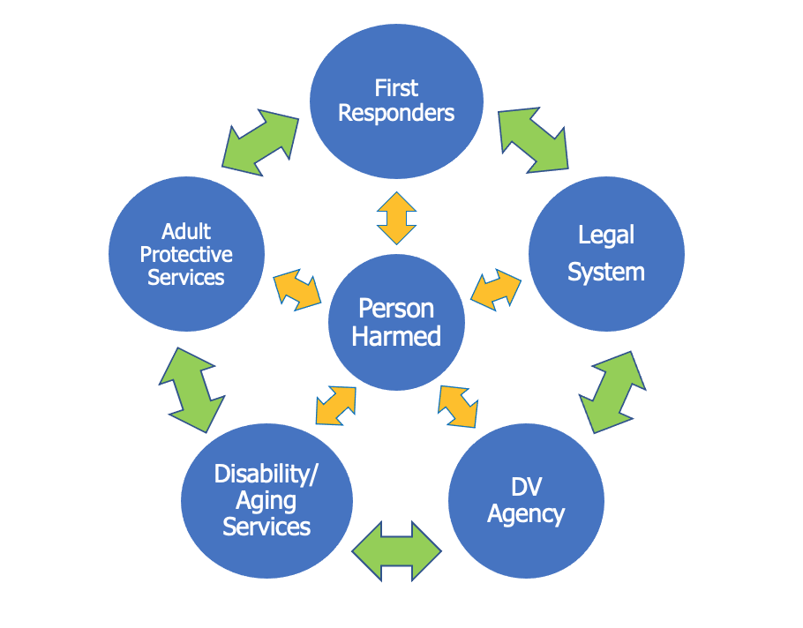
A Trauma-Informed Approach
Notes:
Facilitator Notes:
Say: ”We have learned from the Trauma-Informed Approach that there is another way to do this. In a spirit of building trust and safety, we listen and promote shared decision-making with the person who has been harmed. Notice the bi-directional arrows going from the person harmed to the circles representing the first responders and service providers?
We work to promote transparency and collaboration among providers by coordinating our services and building relationships that defeat the historical and cultural biases that have kept the service system fragmented and siloed. Notice the bi-directional arrows going between organizations and agencies?”

Slide 9
Key Differences in Approach - 1
A collaborative approach with the person who
has been harmed can
Facilitate criminal investigations through a greater awareness of the victim’s needs
Reduce the potential recurrence of criminal behavior through early intervention and community trust in police
Notes:
Facilitator Notes
Say: ”The yellow bi-directional arrow is one of the key differences between the two models shown on slides 6 and 7. The yellow arrow now indicates a more collaborative approach between the person who has been harmed by domestic violence and the first responder or support organization. Now the experience and preferences of the person who has been harmed is equally as important as what the responding agency offers. The individual is the expert on what they need and how they can best be helped. This is a key part of the trauma-informed approach, from first response all the way through to the legal and court proceedings.”
READ SLIDE

Slide 10
Key Differences in Approach - 2
A collaborative approach among the
responding partners can
Connect traumatized individuals to appropriate community services and supports
“Building trust through trauma-informed policing”,
Vera Institute of Justice, March 2015
Notes:
Facilitator Note:
Say: “The green bi-directional arrow is a second key difference between the two models. The green arrow connects system and organizations to each other. Transparency, trust and collaboration among these entities turn the dynamic toward healing and recovery for the person who has been harmed. Organizations learn from the survivor and from each other about how they can better support the individual and the family. Relationships between community partners are strengthened and responses are more fine-tuned as the individual plays a key role in identifying and advocating for their needs.”
READ SLIDE

Slide 11

How to get started: Get to Know Your Community Partners
APS/Older Adult Services
Disability Services
Domestic Violence Services
Faith Based Services
Health Care
Housing
Legal/Justice
Social Services
Notes:
Facilitator Note:
Say: “We will now turn to the community partners you may already be working with or if not, will want to get to know. This slide lists the general categories that are included among the circles we have seen in slides 6 and 7, such as Legal and justice services, Adult protective services, Disability services and domestic violence organizations. But the list expands beyond these for additional important resources in your community, like social services, health care and faith-based services.
Let’s look at the Handout titled ”Get to Know Your Community Partners” for a description of each of these categories and an explanation of some of their unique roles in serving individuals with disabilities and older adults who have been harmed through domestic violence.”
Opportunity for engagement:
ASK for volunteers to pick at least two categories and read the descriptions, including the dot points for the selected categories.
ASK if there are any questions about the description?
ASK if anyone has had any experience engaging with this community partner and would like to share about it with the group? (Be prepared they may share a positive or negative experience). ASK any follow-up questions that may arise after group members share about their experiences.

Slide 12
Partnership in Action
SANE Nurse participating in a joint preliminary interview with law enforcement for a woman with an intellectual disability
ADA Coordinator at court assisting with needed court accommodations for an older adult
A joint investigation with law enforcement and Adult Protective Services
Notes:
Facilitator Note:
Say: There are many examples where partnership in action has made a difference for individuals with disabilities and older adults who have experienced domestic violence. These examples all come from the Protocols for Law Enforcement and for Prosecutors on responding to victims with disabilities who experience sexual assault, domestic violence, abuse, neglect, or exploitation.
READ SLIDE with additional comments, such as:
SANE nurses are skilled in conducting a forensic sexual assault examination for individuals with disabilities and older adults who may need accommodations. They can coordinate their work with law enforcement. (Protocol for law enforcement, section 6, p. 108) Joint interventions like this can help reduce the number of unnecessary professional contacts and benefit the quality of the investigation and the well-being of victims.
ADA coordinators may be a stand-alone position or one of the duties assigned to the Circuit Clerk or Judicial Secretary. The ADA Coordinator can help ensure that any necessary accommodations are made so that the individual with a disability or older adult can fully participate in the judicial process. This may include assisting with transportation logistics, locating the courtroom, and helping arrange a tour of the courtroom. This role is to comply with the Illinois Supreme Court Policy on Access for Persons with Disabilities (see https://www.illinoiscourts.gov/Resources/3654b29e-6c60-4aa3-aa9c-20a79e72f7b9/disability-policy%20(1).pdf )
Adult Protective Services, as we’ve just seen, is the investigative arm of the Illinois Department on Aging for allegations of abuse, neglect and financial exploitation. Joint investigations may also be held with other state investigative entities, like the Office of Inspector General or the Department of Public Health. The primary purpose of a joint intervention is to provide protection to the individual who has been harmed and to utilize law enforcement options that may be available. The model response reminds us to remember to be flexible and to take into consideration the preferences of the individual with a disability or older adult. (Protocol for Law Enforcement, Section 3, p. 32)

Slide 13
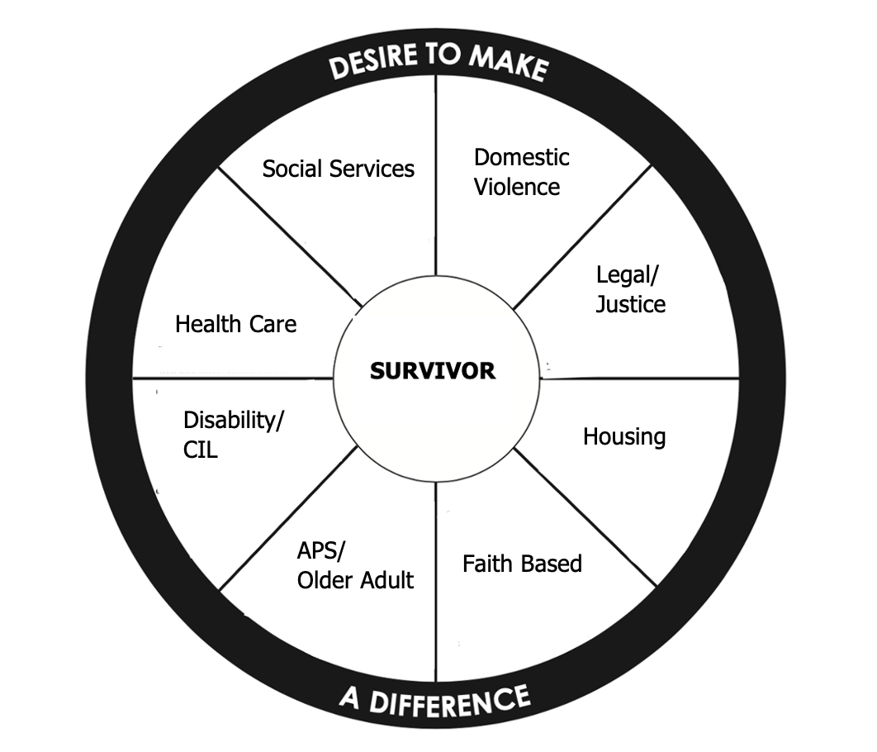
Activity: A Coordinated Community Response
Adapted from
National Center on Domestic and Sexual Violence
Notes:
Facilitator Notes:
Say: “We are now going to move into an activity, based on the Handout and the illustration you see on this slide. The image resembles the picture on slide 7, doesn’t it? We want you to imagine those yellow and green bi-directional arrows going to the survivor in the center and between the different community partner categories listed here. These are the same categories we just reviewed from the Handout “Get to Know Your Community Partners”. This image has been adapted from the Coordinated Community Action Model, developed by the National Center on Domestic and Sexual Violence. The model was designed to demonstrate how communities can accountably act to support adults and children harmed by domestic violence and hold persons causing harm accountable for their behavior. The adaptation was to include community partners that specialize in services to older adults and people with disabilities. The goal of this activity is to help you form a plan of action for establishing or strengthening your relationship with local community partners to better serve those impacted by domestic violence.”
Follow the instructions included in the Activity: “Coordinated Community Response”. Each participant will receive pages 3 – 5 of the Activity, along with the Handout they received on the previous slide.

Slide 14

How to get started: Trauma-informed Response
Ensure safety
Person-guided
Explain options
“Here are some places that might help.”
Support choices
“Would you like any help contacting ______?”
Notes:
Facilitator Note:
SAY: “As we move forward with our plan to develop and strengthen our relationships with community partners, let’s turn back to our engagement with the person who has been harmed.
Knowing that we have a network of community partners who are ready to work with us and with the person who has been harmed, we can be confident that our approach will be trauma-informed by following this guidance.”
READ SLIDE ASK participants to reflect:
“How does this approach support the six core principles of a Trauma-informed approach?”
ASK for examples.
Six Core Principles:
Safety
Trustworthy and transparent
Peer Support
Collaboration and mutuality
Empowerment, voice and choice
Cultural, historical and gender issues

Slide 15

Partnership in Action Success Story
Illinois Department on Aging
#Engage2Change
https://ilaging.illinois.gov/engage.html
Pexels photo by Cliff Booth
Notes:
Facilitator Notes:
In Illinois, we can make this work - a coordinated community response. The local Family Violence Coordinating Council is an example of partnership in action. The Multi-disciplinary teams at local law enforcement agencies or Children’s Advocacy Centers. The Rockford Family Peace Center. The Sexual Assault Response and Resource Team (SARRT). I want to share a success story that comes from the Illinois Department on Aging Adult Protective Services campaign called Engage2Change, as told by the social worker involved in supporting a woman with an intellectual disability.
PLAY AUDIO CLIP OR READ:
“I suspected abuse of a woman who has intellectual disabilities and called to report. I saw a relative hit her and yell at her. After thoroughly and sensitively investigating what was going on, the worker found out she had been forced to have sex with the relative. APS helped get an emergency Order of Protection, counseling, and day services for her. APS even helped to get food for her family, coordinated with a court advocate and worked with the State’s Attorney to pursue charges against the man who abused her. She’s safe now.”
This story talks about coordination between a number of community partners: APS, social work, law enforcement, court – Order of Protection, DV legal advocate, counseling, disability services, Asst. States Attorney, and emergency food. The account goes on to say:
“[This story is] based on real cases received, investigated and resolved by APS. Some details have been changed to maintain confidentiality. Individuals were able to stay in their homes . . . . Their risk of harm was reduced and their quality of life improved.”
Illinois APS story from #Engage2Change
https://ilaging.illinois.gov/engage.html
NOTE:
An alternate success story from NPR Abused and Betrayed series (2018): “How prosecutors changed the odds to start winning some of the toughest rape cases” – 8-minute story
https://www.npr.org/2018/01/16/577063976/its-an-easy-crime-to-get-away-with-but-prosecutors-are-trying-to-change-that
Talks about prosecutors, Children’s Advocacy Centers, SANE nurse, law enforcement, court accommodations (including tour of the court beforehand)

Slide 16
Resources
Model Protocols for Law Enforcement and Prosecutors on Responding to Victims with Disabilities and Older Adults
https://icjia.illinois.gov/ifvcc/crest-illinois/
SAMHSA’s Concept of Trauma and Guidance for a Trauma-informed Approach
https://ncsacw.acf.hhs.gov/userfiles/files/SAMHSA_Trauma.pdf
Supreme Court of Illinois Policy on Access for Persons with with Disabilities
https://www.illinoiscourts.gov/Resources/3654b29e-6c60-4aa3-aa9c-20a79e72f7b9/disability-policy%20(1).pdf

