Slide 1

Communication strategies
This project was supported by Grant No. 2019-WE-AX-0009 awarded by the Office on Violence Against Women, U.S. Department of Justice. The opinions, findings, conclusions, and recommendations expressed in this publication/program/exhibition are those of the author(s) and do not necessarily reflect the views of the Department of Justice, Office on Violence Against Women.
Working with people with disabilities and older adults who have experienced harm through domestic violence
Notes:
Introduction to topic. This is the second in a three-part series on Working with people with disabilities and older adults who have experienced harm through domestic violence. The first part is on Understanding Dynamics. The third part will be focused on Resources in your Community

Slide 2
Learning Objectives
Participants will identify three common-sense strategies to support effective communication with people with disabilities and older adults.
Participants will describe ways to incorporate communication supports in their efforts to achieve full participation by individuals with disabilities and older adults.
Participants will identify two new resources they can use to support their work with older adults and people with disabilities.
Notes:
Facilitator:
The Learning Objectives for this training are the following:
READ SLIDE
Participants will identify three common-sense strategies to support effective communication with people with disabilities and older adults.
Participants will describe ways to incorporate communication supports in their efforts to achieve full participation by individuals with disabilities and older adults.
Participants will identify two new resources they can use to support their work with older adults and people with disabilities.

Slide 3
What do we mean by “Disability”?
Disabilities can be visual, auditory, physical, communicative, developmental or emotional. Some individuals have a combination of disabilities.
Not all disabilities can be seen.
The Americans Disabilities Act (ADA) covers more than 900 different disabilities.
DISability Inability
Notes:
Facilitator Note:
Read slide content. Can add the following quote for emphasis.
“Disabilities, and perhaps more importantly peoples’ reactions to disabilities, create barriers for people with disabilities through stereotypes, myths, prejudices, fears and ignorance.” (‘People First’), LE, p. 51, Prosecutors, p. 74)
See Protocol, LE and Prosecutor, Definitions, pp. 13-14 (LE); p. 14 (Prosecutors)
Also see handout on People First, Protocol for LE, section 5, p; 50 – 51; Protocol for Prosecutors, section 3, p. 74
For additional context and information.

Slide 4
What do we mean by “Older Adult”?
As defined in Illinois Compiled Statutes, an elderly person means a person 60 years of age or older. Although older adult is the preferred term for someone 60 and older in Illinois, statutory definitions use the term elderly person.
More than one in every seven Americans is over age 65. (2020 data) This number is expected to grow.
Notes:
Facilitator Note:
Read slide content.
Say: These two slides help ground us in the definitions of who we are referring to when we say people with disabilities and older adults. I think it is important for us to understand that we are talking about a fairly large group of people, some of whom we might easily recognize as belonging to these groups and some who are not so easily identified as a person with a disability or older adult.
Facilitator Note: More information can be found in Protocol, LE and Prosecutor, Definitions, pp. 13-14 (LE); p. 14 (Prosecutors)

Slide 5
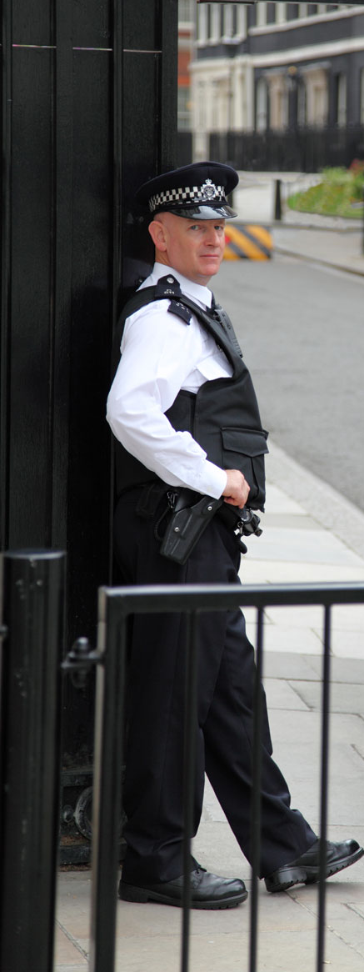
Activity: First Response
5 Questions
4 Communication needs
3 Initial steps
Notes:
Facilitator SAYS:
We are going to do an activity (depending on size of the group it may work best to divide into small groups). For this activity, we will base our conversations on the following scenario. (READ THE FOLLOWING):
A 911 call was placed by a neighbor who heard a loud and destructive fight going on in the apartment next door. The neighbor was concerned about the elderly woman who lives in the apartment with her adult daughter and the daughter’s husband. In the past she has seen the elderly neighbor with bruises on her face but hesitated to ask because she was always with her daughter who always seemed in a hurry.
The responding officer first spoke to the neighbor who made the 911 call. Next, the officer arrived at the apartment and was greeted at the door by the daughter’s husband who spoke with limited English. The officer asked to speak to the other members of the household and was ushered into the living room. The officer noticed a broken lamp in the corner of the room, with a broom nearby.
The elderly woman entered the room escorted by her daughter and appeared to be leaning on her for support. She was cradling her left arm. She appeared confused and looked at her daughter before speaking. Her speech was difficult to understand. The daughter seemed edgy and nervous and began talking rapidly, answering for her mother and looking furtively at her husband.
Activity: Follow instruction on the Activity Coversheet for this activity. The Facilitator should remind participant to focus on the communication challenges and needs in their discussion. The purpose of this activity is to figure out how they will approach the necessary interview(s) and not to solve whether a crime has happened or not.
Participants will use the handout to write down the first 5 questions they have about this situation. Then identify 4 possible communication needs and challenges. Finally, what would be 3 initial steps they might take in order to interview the parties involved, especially the older adult. After they complete the activity, facilitate a large group discussion of their responses. Allow 5 – 10 minutes for this activity, depending if facilitator opts to divide them into small groups for the activity.
Prompt: What clues in the environment can give the officer an idea of the communication challenges and what might help with the interview?

Slide 6
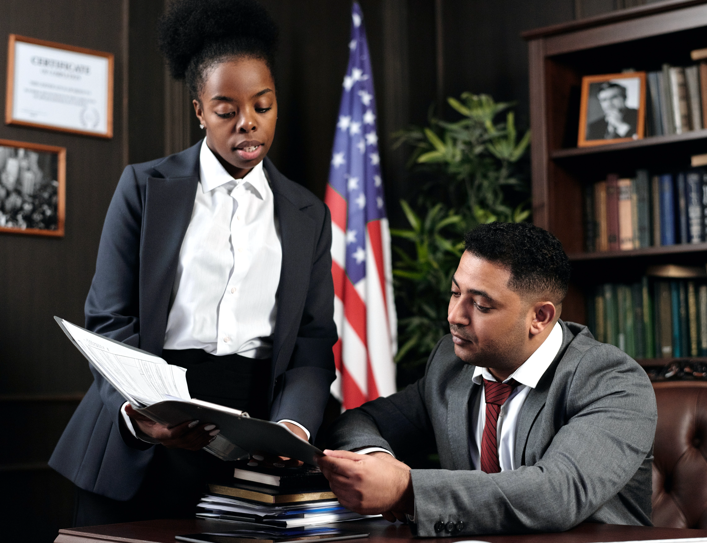
Common-sense Strategies
Photo by August de Richelieu: Pexels
Notes:
Facilitator Notes: Follow up from discussion to introduce this next section. Incorporate any meaningful strategies and experiences shared during the large group discussion.

Slide 7
Setting up good communication
Establish rapport and trust with the person who has been harmed
Presume Competence
Determine what is needed to ensure a successful interview
Notes:
LE Protocol, Section 3, pp. 22 – 23
Facilitator:
“For a successful interview, the officer must establish rapport and respectful communication with the person who has been harmed. A key element of this is approaching the individual within the framework of presumed competence.”
Presumed competence means the officer presumes the individual with a disability or older adult is able to participate in an interview and the criminal justice process.
Steps the officer can take to assess for understanding and for the best means to communicate with the individual:
(When possible, the officer will want to gather some initial information before interviewing the person.)
Determine if the person has any kind of disability and/or receives any sort of support services.
Find out how this disability may affect the interview process; each person is unique so further information will be gathered when you meet the person. Remember they are the expert on what they need to participate.
Determine if the person uses any adaptive equipment, such as a hearing aid, crutches, cane, communication device (which may be an iPad) or a wheelchair.
Determine if the person has any attention difficulties.
Determine how the person best communicates their wants and needs.
Determine what makes it easiest for the person to understand what others communicate
When possible, arrange for a victim advocate from the local DV agency to be present to support the person outside of the interviewing space to protect confidentiality.
Prosecutor Protocol, section 2, p. 34
Best Practice: Making an assumption about accommodations is not necessary when you are working with the expert. Asking the person with a disability or older adult, “Is there anything I should know about you to help us work better together?”

Slide 8

Helpful Tip -1
Start with the assumption you can communicate. If you cannot understand, don’t pretend you can.
Notes:
LE protocol, Section 6, p. 142
Start with the assumption you can communicate.
“First, you should start from the assumption that you can have a normal conversation with the person who has been harmed. Unless they have a severe cognitive or communication disability, you should be able to communicate effectively, even if it takes a while to become accustomed to their ‘speech patterns, inflections, and accent’” (Office for Victims of Crime, 2011, p 21)
”You should also allow sufficient time for this natural process, but monitor the length of the interview, because this can become burdensome for the individual. (ibid). Also try to ‘focus on what the person is saying, rather than how they say it’ and ‘do not try to finish the individual’s sentences or thoughts’”. (SafePlace, 2007)
Prosecutor protocol, section 3, pp. 93 – 95 Interviewing Tips
For investigators and prosecutors, “schedule extra time for an interview, so you do not feel rushed. Provide facts about who you are, what you are going to do, and what happens next. Ask only one question at a time and allow time for an answer. Break down all tasks into simple steps. Giving too many directions at once or too quickly will only increase confusion..
LE Protocol, section 6, pp. 142-143 If you cannot understand the person who was harmed
”If you find that you cannot understand the person who was harmed, no matter how hard you try, do not pretend that you do.” Consider using these suggested strategies. (next slide)

Slide 9
Helpful Tip -2
Wait
Repeat
Rephrase
Identify the misunderstanding
Try spelling or writing it out
Get help
Notes:
LE protocol, Section 6, p. 142-143
Strategies suggested by SafePlace (2007)
Wait – listen to the whole sentence or phrase. Wait for a second and try to relax. Use the conversational context to help you.
Repeat – Simply repeating the sentence or thought may be enough. There are time, though when repeating will not help because the speaker is not going to be able to change the way a specific word is pronounced. If repeating does not work, move on to another strategy.
Rephrase – Ask the individual to try and express the same thought using various words. Often the misunderstanding hinges on one or two words in a sentence.
Identify which part of the sentence or thought was misunderstood. If you know most of the phrase and can identify which part(s) are unclear, you might try repeating what you know, and ask them to focus on finding a way to communicate just the part you did not get.
Spelling or writing – once you have located the word you do not understand, ask the individual to spell it or write is down. It may only take the first few letters of the word to clear up the confusion. (Alternatively, you can spell or write it)
Get help – if nothing else is working, you may want to ask the person if there is someone who might assist in communications.
NOTE: if you do have someone assist, carefully consider if this other party is safe or will have opinions that influence their interpretations. Do not allow this person to add or critique what the person who was harmed says or to comment about the crime itself. The person who was harmed must know that you believe their statements. (SafePlace, 2007, pp 63-64)

Slide 10
Helpful Tip -3
Trauma-informed interviewing
Acknowledge the trauma/pain
Focus on the individual’s experience rather than a sequential reporting of events
Reference the five senses during the interview
Russell Strand “The Forensic Experiential Trauma Interview ”
Notes:
Facilitator
“Many people with disabilities may have experienced a lifetime of small and large traumas. This may include a lifetime of people trying to ‘fix’ them, extended hospitalizations, bullying, name calling or segregation. It is safe for law enforcement to presume that people with lifelong disabilities have experienced some sort of trauma. Similarly, older adults may experience trauma due to the grief of losing skills, role changes with family members, loss of loved ones and the resulting isolation.”
Using techniques drawn from the Forensic Experiential Trauma Interview” (FETI) developed by Russell Strand can help the officer and prosecutor approach the interview in a trauma-informed way, establish rapport with the individual who has been harmed and ensure better outcomes.
“Some of his suggestions include focus on the individual’s experience rather than a sequential reporting of events.”
“Referencing the senses during the interview, i.e., Asking ’What did you hear? See? Smell? Taste? Feel?’ And understanding the biochemistry and brain response to trauma.”
Sources: LE Protocol, section 3, p. 26 Trauma-informed Response
LE Protocol, section 6, pp. 147 – 156 for Russell Strand “The Forensic Experiential Trauma Interview”

Slide 11
Helpful Tip – 4
Educate about Rights
Confidentiality – individuals with disabilities and older adults have a right to confidentiality.
Arrange for a Sexual Assault/Domestic Violence Advocate to be present to support the person outside of the interviewing space to protect confidentiality.
Respect and protect the confidentiality and the wishes of the person who was harmed regarding the notification and participation of others throughout the investigation.
Notes:
Facilitator
Many people with disabilities and older adults will have little to no experience moving through the legal process. They may not understand about their rights to confidentiality and privileged communication.
Understanding about confidentiality and privileged communication can support the person who has been harmed to trust law enforcement and court personnel because they will feel more in control of who will have access to information they share with their sexual assault/domestic violence advocate and counselor. Illinois law states that the sexual assault/domestic violence advocate and counselor has protection to maintain confidentiality about what is shared with them in private (privileged communication).
Law enforcement and court personnel can help support this confidential communication by ensuring that that the SA/DV advocate can support the person outside of the interviewing space where law enforcement or the prosecutor is gathering information to pursue an investigation or move to trial.
Another way for law enforcement and prosecutors to be aware of the confidentiality rights of the person who was harmed is to work with them about the notification or participation of others throughout the investigation. Steps like these can go a long way to support healing and are part of trauma-informed approach.

Slide 12
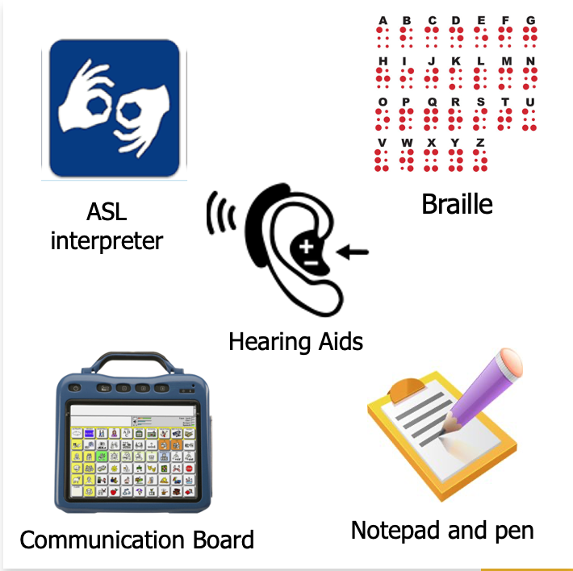
Communication Supports
Notes:
Section transition
Facilitator
Let’s go back to the scenario we opened with. We’ll call the elderly woman Maria. Our discussion raised possible communication needs Maria may have and how we could address them. If Maria was deaf and uses American Sign Language to communicate, then an ASL interpreter is needed. If Maria is hard of hearing, having her hearing aids may be the first step to improving communication. Similarly, if Maria uses a communication board or some other type of augmentative communication device, then having that available will help Maria indicate what she needs. And, as we just discussed in the previous slide, it may be that using a writing pad and pen to figure out a word or phrase you cannot understand will help open the communication. In this section, we will look more closely at the range of communication supports you may draw upon in your work with Maria and other individuals.
In the words of people with disabilities, “Everyone communicates. We may not communicate the same that you do so you might think you can’t understand us. Some of us communicate with devices, some of us use pictures, and some of us can show you with gestures and pointing. Take the time to get to know how we communicate. Together we can figure out lots of things. Please give us time and we will help the best we can.”
(LE Protocol, section 6, p. 62)

Slide 13
ADA – American with Disabilities Act, 1990
Requirements for Effective Communication with People who are Deaf or Hard of Hearing
Law enforcement:
Must provide communication aids and services needed to communicate effectively
Cannot charge the person for the communication aids or services provided
Must provide interpreters who can interpret effectively, accurately and impartially, when needed
Notes:
LE Protocol, Section 5, pp. 54 – 57
Facilitator:
“As a law enforcement [or court] officer, you can expect to come into contact with people who are deaf or hard of hearing. It is estimated that up to nine percent of the population has some degree of hearing loss, and this percentage will increase as the population ages. Under the American with Disabilities Act (ADA, 1990), people who are deaf or hard of hearing are entitled to the same services law enforcement [and the courts] provide to anyone else. They may not be excluded or segregated from service, be denied services, or otherwise be treated differently than other people. This applies to both sworn and civilian personnel.”
It is important to become familiar with your organization’s policy regarding communicating with people who are deaf or hard of hearing.

Slide 14
Helpful Tip - 5
Speak directly to the individual who is deaf or hard of hearing, rather than the interpreter.
In cases of domestic violence, best practice is NOT to use a family member or other household member to interpret for the deaf/hard of hearing individual.
Notes:
LE Protocol, Sec. 5, pp. 47-49 The Ten Commandments (Etiquette)
Facilitator:
“Etiquette for communicating with people with disabilities and deaf people. You may not always be aware that a person has a disability. These tips are helpful in communicating with anyone.”
Speaking directly facing that person rather than their companion or a sign language interpreter who might be present. This indicates respect for the person, even if you think the person cannot understand or respond to you. Some deaf/hard of hearing individuals can also read lips and may be able to understand some of what you are saying.
LE Protocol, section 5, pp. 54 – 57 ADA Guide for Law Enforcement Officers
However, “remember only about one third of spoken words can be understood by speech reading.
When using an interpreter, talk at your normal rate, or slightly slower if you normally speak very fast.
Only one person should speak at a time.
Use short sentences and simple words.”
“Interpreter services are not required for simple transactions – such as checking a license or giving directions to a location – or for urgent situations – such as responding to a violent crime in progress. However, an interpreter may be needed in lengthy or complex transactions – such as interviewing a victim, as witness, suspect, or arrestee – if the person being interviewed normally relies on sign language or speech reading to understand what others are saying.
It is inappropriate to ask a family member or companion to interpret in a situation like domestic violence because emotional ties may interfere with the ability to interpret impartially.”
You may not understand or be aware of all the dynamics present between family or household members. Using a family or household member as the interpreter may affect the victim’s willingness to share information. It may also impact their trust in your skills and understanding, which will ultimately impact your ability to complete your investigation or representation.

Slide 15
Helpful Tip - 6
Did you know ASL interpreters are required to have a license to provide interpreting services?
You can search by region/county for ASL interpreters using the Interpreter Directory - Illinois Deaf and Hard of Hearing Commission
Notes:
Facilitator: (the following is copied from the Illinois Deaf and Hard of Hearing Commission Interpreter Director webpage)
Under the Interpreter for the Deaf Act of 2007, interpreters are required to have a license to provide interpreting services after January 1, 2009, unless an exemption applies. Interpreter licenses are based on proficiency levels. The proficiency levels determine which interpreting assignments an interpreter can accept. The actual licenses are color coded:
General-Master: Silver General-Advanced: Green General-Intermediate: Yellow Provisional: Red
You can do a search on the directory by an interpreter's name or by region/county. The listings are in order by the interpreters' licensed proficiency level, from Master to Provisional. To find an interpreter in a specific area, click on the region of where services are needed. Then a list of local licensed interpreters and their contact information will be displayed.
We have provided the link to the Illinois Deaf and Hard of Hearing Commission Interpreter Director on the Resource Handout. (The link is also included here on this slide.)

Slide 16
Communicating with someone who is blind or has low vision
Identify yourself and any others who are with you.
If asking questions, identify who you are directing
the question to.
Read any documents out loud if the individual
needs to sign them
Plan ahead: have documents that are frequently
used available in large print or braille
Notes:
LE Protocol, Section 5, p. 48, Section 6, p. 71
Facilitator:
Here are some helpful reminders when communicating with someone who is blind or has low vision.
“When meeting a person with low vision, always identify yourself and others who may be with you. When conversing in a group, remember to identify the person to whom you are speaking as well as yourself.”
“To effectively communicate with someone who is blind or has low vision, it is important for officers [and court personnel] to identify themselves and to state clearly and completely any directions or instructions – including any information that is posted visually. Officers must read out loud in full any documents that a person who is blind or has low vision needs to sign.” It is a good idea to describe the procedures in advance so that the individual will know what to expect.
Source: Commonly Asked Questions About the Americans with Disabilities Act and Law Enforcement by United States Department of Justice - published 04/04/2006

Slide 17
Plain language and Easy Read documents
For individuals with cognitive disabilities, using plain language and easy read documents greatly benefits communication.
Plain Language (spoken and written): communication your audience can understand the first time they hear it or read it.
Easy Read (written documents): a style of writing using clear, easy-to-understand language paired with a picture icon.
Notes:
Facilitator:
In this case, we will be using the definition of cognitive disability from the National Crime Victimization Survey (NCVS), as well as the U.S. Census Bureau’s American Community Survey (ACS), which classified disability according to six limitations. “Cognitive disability includes any serious difficulty in concentrating, remembering, or making decisions due to a physical, mental, or emotional condition.”
(Source: U.S. Department of Justice, Bureau of Justice Statistics, Crime Against Persons with Disabilities, 2009-2019.
https://bjs.ojp.gov/content/pub/pdf/capd0919st.pdf )
Using this broad definition, cognitive disability can include someone with intellectual/developmental disabilities, including autism; dementia or Alzheimer’s Disease; mental illness or traumatic brain injury. Being familiar with how to communicate using plain language and having documents available in easy read or plain language will make the entire process more accessible and increase the chances for a good outcome.
Plain language is simple, straightforward language and writing that is clear, concise and well-organized. To communicate in plain language:
Use an active, rather than a passive voice.
Use short sentences and paragraphs.
Use common, everyday words
In writing, plain Language does not have pictures, and is usually written between a 6th and 8th grade reading level.
Easy Read is a style of writing that uses clear and easy-to-understand language. Each sentence in an Easy Read document is shown next to a picture icon to illustrate the information in that sentence. This helps people who are visual learners to better understand the content. Easy Read documents only use one sentence per line.
Easy Read and Plain Language communication follows the principles of Universal Design in that it makes information accessible. When you make information accessible, you are including people. When you don’t, you are excluding people. There are lots of different groups that may have trouble reading documents at a high reading level. People with intellectual and developmental disabilities are just one of those groups. Plain language and easy read communication may also benefit people who speak English as their second language, people with language processing disabilities, or older adults who may have trouble seeing or understanding information. Any of these individuals may struggle to read inaccessible resources.
We want to give you the tools you need to include more people!
(Sources: PlainLanguage.Gov is an official website of the General Services Administration.Fa https://www.plainlanguage.gov/about/definitions/ and
One Idea Per Line by the Autistic Self-Advocacy Network (ASAN) https://autisticadvocacy.org/wp-content/uploads/2021/07/One-Idea-Per-Line.pdf )

Slide 18
Example: Before and After
Access to Justice Principle 3:
Persons with disabilities, including children with disabilities, have the right to appropriate procedural accommodations.
3.1 Guidelines:
To avoid discrimination and guarantee the effective and equal participation of persons with disabilities in all legal proceedings, States shall provide gender- and age-appropriate individualized procedural accommodations for persons with disabilities. They encompass all the necessary and appropriate modifications and adjustments needed in a particular case, including intermediaries or facilitators, procedural adjustments
and modifications, adjustments to the environment and communication support, to ensure access to justice for persons with disabilities. To the fullest extent possible, accommodations should be organized before the commencement of proceedings.
Access to Justice Principle 3 (Easy Read):
Adults and children with disabilities have the right to have changes that help them to use the police and courts.
3.1 Guidelines (Easy Read):
This means the courts should change the way they do things to stop discrimination against adults and children with disabilities. This includes support with communication, understanding what is happening and being able to take part. If possible, these changes should happen before the person goes to court.
Notes:
Facilitator:
(NOTE: This slide contains an Animation)
SAY: Here’s an example from the United Nations International Principles and Guidelines on Access to Justice for Persons with Disabilities (2019). This project was designed as a practical tool to support nations in designing and implementing justice systems that provide equal access to justice for persons with disabilities, in line with international human rights standards. The project includes the original document and an easy read version in English, French and Spanish. There are 10 Principles, which have corresponding Guidelines and then specific suggestions on how the Principle and Guidelines can be implemented.
Let’s compare how the same section, in this case Principle 3 of the document and the first Guideline listed under that Principle are presented in the original document and the Easy Read version. Starting with the text from the original document, we can read the language from the text box on the left side of this slide: (READ SLIDE – TEXT BOX ON LEFT SIDE)
(CLICK FOR ANIMATION. SECOND TEXT BOX ON RIGHT SHOULD APPEAR)
Now, let’s compare that with the way the Easy Read version states the same Principle and Guideline. (READ SLIDE – TEXT BOX ON RIGHT SIDE).
Questions for Discussion:
What do you notice?
Who might benefit from the Easy Read version?
How can the principles of Easy Read apply to your work?
The link to find these valuable document is included as a resource at the end of this presentation.
The United Nations International Principles and Guidelines for Access to Justice for Person with Disabilities:
https://www.ohchr.org/en/special-procedures/sr-disability/international-principles-and-guidelines-access-justice-persons-disabilities

Slide 19

Activity: Plain language communication
Notes:
Facilitator: Now let’s do an activity where we can practice using Plain Language or try converting what we want to communicate into Easy Read, using picture icons to accompany the information.
SEE ACTIVITY COVERSHEET: Plain Language Communication

Slide 20
Helpful Tip - 7
Unique ways prosecutors have used the ADA to give victims a voice:
Illinois - victim communicated by blinking “Yes” or “No”
California – Victim tapped a pencil for “Yes” or “No”
Washington – Victim testified in presence of a support animal
Notes:
Facilitator:
It is important that we bust the myths around who can be a credible witness and what is needed for testimony in court to be successful. On this slide are some true examples demonstrating creative and resourceful approaches to ensure the person with a disability or older adult who has been harmed can use their “voice” in court, even without always speaking.
READ SLIDE
These courageous prosecutors used the Americans with Disabilities Act (ADA) to argue for the accommodations needed to permit the person with a disability to testify.
“In Illinois, all witnesses are presumed competent to testify and the burden of establishing incompetence is on the party raising the challenge. As the long as the witness understands the importance of the oath to tell the truth and is able to communicate, that witness should be found competent to testify. This is true even if the witness is not capable of speech, provided she or she can communicate by other means.”
“This raises the question of what other means of communication are acceptable. It is difficult to formulate a straightforward legal rule in light of the varying nature and extent of the myriad disabilities that may need to be accommodated. The trial court has great discretion in determining what procedure will be followed. In the case of a witness who is not able to use words to speak, accommodations might include:
Written questions and answers
Written statements
Hand signals or sign language with the aid of an interpreter
Gestures in place of actual speech
Communication devices can also be used”
(Prosecutor Protocol, section 2, p. 53)

Slide 21
Resources
Notes:
Section transition
Facilitator

Slide 22
Communication Card - 1
Notes:
Facilitator
Created by the Responding to People with Disabilities and Older Adults Committee of the CREST Illinois project, the Communication Card is a great example of an Easy Read document that can help first responders, investigators and court personnel establish rapport and develop a safety and communication plan. This shows the first page of the Communication Card, which focuses on asking “Are you safe?” indicating the individual’s home environment and the people they live with. A thumbs up or down can signify their response if the person does not use words or does not feel safe to use words.
The second question: “How can I help you?” gives the individual the opportunity to indicate what they may want or need to do.
(next slide)

Slide 23
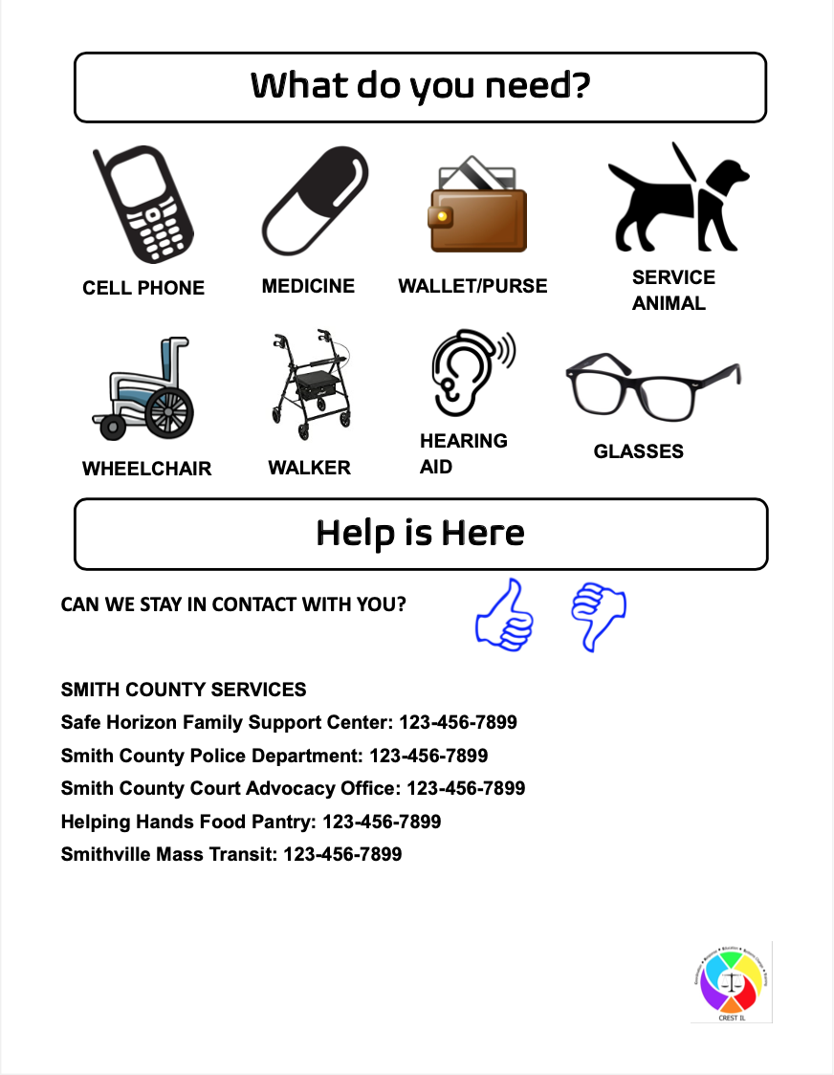
Communication Card - 2
Notes:
Facilitator:
On the second or flip side of the Communication Card, the card asks, “What do you need?” and indicates several items that might help support the individual, such as their service animal, hearing aid, glasses or medication. Finally, the “Help is Here” section lists local resources in the individual’s community and provides the opportunity for the individual to show a thumbs up or thumbs down if they would like to contact or be linked to that organization.
You can access a copy of the Communication Card and personalize it to your community at the following website:

Slide 24
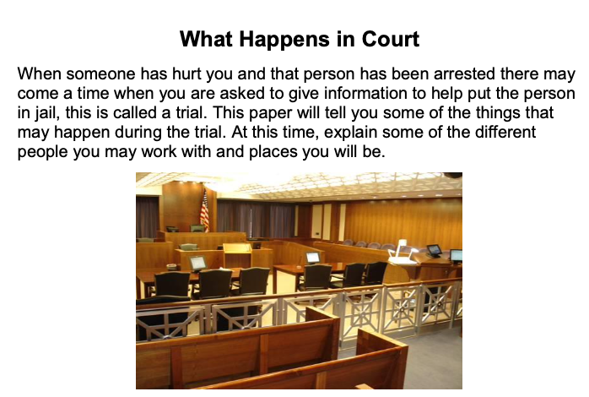
What Happens in Court
Notes:
Facilitator:
In the Prosecutor Protocol, there is a resource called “What Happens in Court”. Using plain language and images, this document explains the key roles of people involved in the criminal justice process at the court, including prosecutor, court advocate, judge, jury, etc. It also explains different settings at the courthouse, like the courtroom and the state’s attorney office. Then there is a listing of terms that may be used at the court, along with an explanation of their meaning, like “arraignment” is “when a person is brought into court and told what they are being charged with, they are asked to plead guilty or not guilty. This is called an arraignment.”
You can find this resource in the Prosecutor Protocol, section 3, pp. 122 – 126.

Slide 25
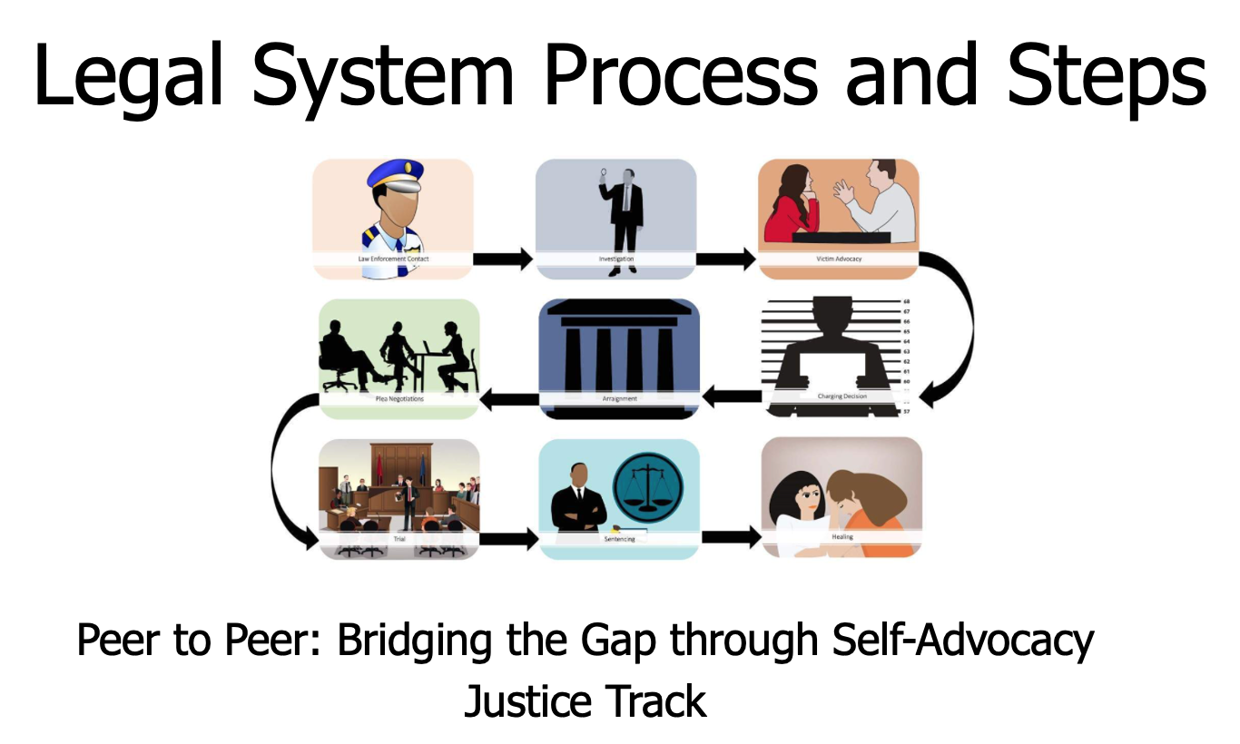
Legal System Process and Steps
https://www.ilcadv.org/envision-illinois/?type=14
Notes:
Facilitator:
Another great accessible resource about the legal system process, that is in Easy Read format comes from Envision Illinois. This resource has been adapted from the Peer to Peer: Bridging the Gap through Self-Advocacy Curriculum, Justice Track, published by the Vera Institute of Justice, End Abuse of People with Disabilities project. You can find this tool on the Resource Corner for Envision Illinois. It is designed as PowerPoint slides so it can be loaded onto an iPad or tablet to show the various steps in the legal system process. There is one for the Legal System Process and another for Who’s Who in the Legal System.
For example, the first slide shows the image of Law Enforcement. The title states, “Contact with Law Enforcement” and the text next to the image states “The first step in the criminal justice process is contact with law enforcement. They are told that a crime has happened.” As you can see, easy to understand language paired with an image follows the Easy Read format.

Slide 26
Additional Resources
Protocol for Law Enforcement, Responding to Victims with Disabilities and Older Adults, Section 5 on Communication
Protocol for Prosecutors, Responding to Victims with Disabilities and Older Adults, Section 2 on Model Response Procedures and Section 3 on References and Resources
International Principles and Guidelines for Access to Justice
One Idea Per Line, Autistic Self-Advocacy Network
Notes:
Facilitator:
On this slide, we have listed the specific areas of the Protocols relating to Communication Strategies. We have also listed the two guides referenced explaining about Plain Language and Easy Read.

Slide 27
Illinois-Specific Resources
Interpreter Directory - Illinois Deaf and Hard of Hearing Commission
Illinois Network of Centers for Independent Living (INCIL) – Find Your CIL
Illinois Assistive Technology Program
Adult Protective Services – Illinois Department on Aging
Child Advocacy Centers (in cases of sexual assault)
Notes:
Facilitator:
Some Illinois specific resources include the Interpreter Directory for locating licensed interpreters in American Sign Language. We can also recommend you become familiar with the Center for Independent Living in your area, as they can be a great resource to figure out particular communication challenges you may come across. The Illinois Assistive Technology program has many resources and expertise on assistive devices to aid communication. And finally, Adult Protective Services and Child Advocacy Centers may be helpful in investigations and adapting forensic interviews to best communicate with a person with a disability or an older adult with communication challenges.

