Slide 1

Dating Violence in Adolescents and Young Adults
P LE and P: R V DV, Ch. 4, pgs. 10-13, Ch. 5, pgs. 12-13
This Photo by Unknown Author is licensed under CC BY-SA-NC
Notes:
.

Slide 2
Learning Objectives​
Identify indicators of adolescent and young adult dating violence
Learn about stalking in adolescent/young adult dating violence
Identify next steps after responding to an adolescent/young adult dating violence situation
Learn about heteronormativity in adolescent/young adult dating violence

Slide 3
Prevalence
What is Adolescent and Young Adult Violence?
Physical Violence and Abuse
Sexual Violence and Abuse
Stalking
Psychological abuse
Notes:
Definition of AYA: a range of abusive behaviors, including physical & sexual violence, stalking and psychological abuse that preteens & adolescents experience in the context of a past/present dating relationship.
It’s important to note that teens experience the cycle of violence similarly to adults. There is typically a clear tension building phase, violent explosion and calm phase.
1 in 3 adolescents have been a victim of TDV and 1 in 4 have committed relationship abuse.
2017 about 1 in 10 Illinois students reported physical dating violence and 1 in 12 reported sexual dating violence
LGBTQ youth are at a greater risk
43 percent reported being victims of physical dating violence, compared to 29 percent of heterosexual youth;
59 percent reported emotional abuse, compared to 46 percent of heterosexual youth;
37 percent reported digital abuse and harassment, compared to 26 percent of heterosexual youth; and
23 percent reported sexual coercion, compared to 12 percent of heterosexual youth.
Same Violence, Different Challenges: Relationships and Dating Abuse in the LGBTQ Community | Break the Cycle
Referenced from: https://www.breakthecyle.org/blog/same-violence-different-challenges-relationships-and-dating-abuse-lgbtq-community
www.laurashouse.org: https://www.youtube.com/watch?v=8wem8wzU5zw
**This video is intended to demonstrate what teens go through in an abusive relationship. You can ask your participants if they can pick out the three phases in the Cycle of Violence and where they noticed them.

Slide 4
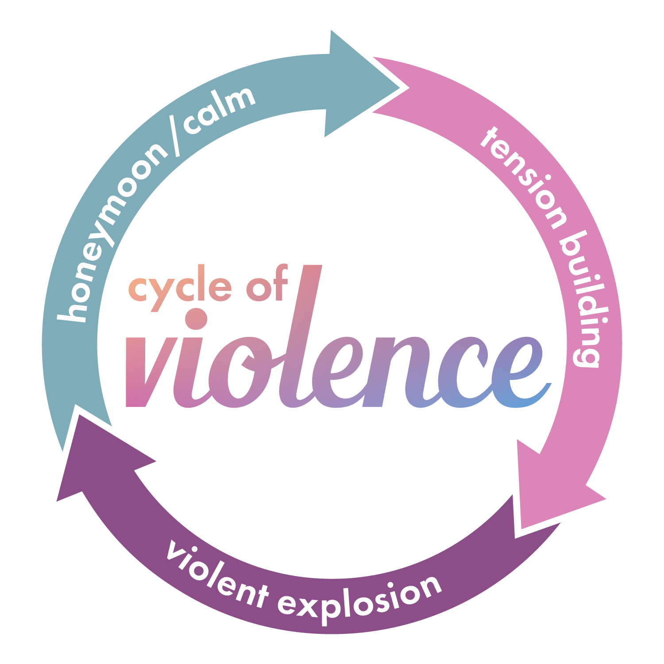
Notes:
Everyone experiences domestic violence differently. One of the common patterns we see in domestic violence relationships is the cycle of violence. Not all DV relationships follow this pattern.​
Tension Building: something happens and upsets the violent partner -​
I told you not to wear that shirt ​
Why are you talking to that person, you know I don’t like them​
You didn’t text me back, what were you doing​
​
Violent explosion: where the abuse takes place –​
Physical Abuse​
Sexual Abuse​
Emotional Abuse​
Cyber/Digital Abuse​
Verbal Abuse​
​
Honeymoon/Calm: when everything is “alright” of a period of time​
Buy them chocolates ​
Take them on dates ​
Apologize ​
Make promises (it’ll never happen again) ​
Profess their love ​
In the beginning, the cycle tends to take longer periods of time. As the relationship goes on, the phases take less time or may be skipped altogether.
​
** As Law Enforcement, you may not see all the phases, however, take what you know about adults and domestic violence and apply it to adolescent and young adult s as well. Sometimes, they see no way out.

Slide 5

LGBTQIA+ individuals are incredibly diverse and come from all racial, ethnic and socio-economic backgrounds.
Notes:
• Sex describes the biological/physical concept of Female & Male
• Gender is based on cultural/psychological traits associated with Females & Males.
• Gender Identity describes the gender with which a person identifies (i.e., whether one perceives oneself to be a man, a woman, or describes oneself in other ways).
• Sexual Orientation refers to a person's emotional, romantic & sexual attraction to individuals of a particular gender.
• The L: Lesbian – A woman who is predominately or exclusively attracted to women emotionally, physically, spiritually and/or sexually.
• The G: Gay – A term identifying a man who is predominantly or exclusively attracted to men emotionally, physically, spiritually and/or sexually.
• The B: Bisexual – A term identifying a person who is attracted to men and women emotionally, physically, spiritually and/or sexually.
Note: The L, G and B relate to a person’s Sexual Orientation
***See attached Scenario Activities 1 and 2
*They are stand alone activities use either and/or both

Slide 6
Barriers
What prevents adolescent and young adults from reaching out for help:
Parents/Family
Feelings
Stereotypes
Perception
Loss of independence
Notes:
Parents/Family:
Afraid their parents will make them break up
Convinced parents will blame them or be disappointed
Aspects of life over which adults have much more control, for example, adolescent and young adults may have little input over their schedules, which schools they attend, how to get to and from school, activities in which to participate, where they work, or where they worship.
Feelings:
They are embarrassed and ashamed
Afraid of getting hurt by their partner
Convinced it’s their fault
Stereotypes:
They are confused – they may think this is what dating is
Perception: Specifically in the LGBTQ+ community -
They may fear they’re not believed
Afraid they’ll be met with a homophobic counselor or officer
Fear of myths like “two men fighting is normal” “two women cant hurt each other” “these types of relationships aren’t stable”
They may not be out to their friends/family yet and therefore don’t want to report abuse
Same Violence, Different Challenges: Relationships and Dating Abuse in the LGBTQ Community | Break the Cycle
https://www.breakthecyle.org/blog/same-violence-different-challenges-relationships-and-dating-abuse-lgbtq-community
Loss of Independence:
Afraid of losing privileges like being able to stay out late, using the car or able to have technology
Other:
…Additionally, many adolescent and young adult and adult victims alike experience abuse which intersects with discrimination and institutional biases based on race, culture, religion, sexual orientation, gender identity, immigration status, and language barriers, and adolescents with disabilitiesthat make abuse harder to overcome and create additional challenges to receiving desperately needed services.

Slide 7
Indicators
Physical
Bruises
Scratches
Burns
Pregnancy
Appearance Changes
Unexplained Illness
What are the warning signs?
This Photo by Unknown Author is licensed under CC BY-SA-NC
This Photo by Unknown Author is licensed under CC BY-SA-NC
Notes:
Physical:
Bruises, scratches, burns, or other injuries
Pregnancy – some adolescent and young adult agers believe that having a baby will help make things better; some girls are forced to have sex
Changes in Appearance
Sudden or Unexplained Illness

Slide 8
Indicators
Emotional
Depression
Mood changes
Low self-esteem
Overly emotional
Self-harming
What are the warning signs?
This Photo by Unknown Author is licensed under CC BY-SA-NC
This Photo by Unknown Author is licensed under CC BY-SA-NC
Notes:
Emotional:
Experiences depression​
Mood changes
Low self-esteem​
Overly emotional/cries frequently
Self-harming

Slide 9
Indicators
Behavioral
Appearance change
Falling grades
Avoiding friends
Habit changes
Hypervigilance
Substance abuse
What are the warning signs?
This Photo by Unknown Author is licensed under CC BY-SA-NC
This Photo by Unknown Author is licensed under CC BY-SA-NC
Notes:
Behavioral:
Sudden changes in clothes or make-up
Failing grades or dropping out of school activities
Avoiding friends
Difficulty making decisions
Changes in eating or sleeping habits, avoiding eye contact, having “crying jags”
Constant checking in/texting or FaceTiming their partner
Using drugs or alcohol
Isolating from family/friends
Hyper-vigilant – looking out for partner/easily startled
Reproductive abuse/control

Slide 10

Notes:
See attached Scenario Activity 3
Instructions: Read Scenario 3 with your training group.
Scenario 1:
You’ve been assigned to the local high school as the School Resource Officer. Every morning while students enter the building, you are posted in the commons area. You observe student behavior regularly. You know there is a young couple in the building that seems to always be arguing. You’ve seen them together before classes many times. You watch the demeanor of the young man change over the course of the last couple months. He used to hang out and chat with his friends before classes, now he follows behind his girlfriend, doesn’t make eye contact with his friends, teachers or you. He has been leaving school looking upset recently. For a student that used to be so charismatic, he’s been despondent. He also no longer dawns the school basketball jersey on game days, and you overheard a conversation between him and his English teacher about not turning in homework and a near failing grade.
Ask the follow up questions to walk through the scenario.
Debrief Questions:
1. What indicators of adolescent and young adult dating violence is he exhibiting?
Avoiding friends (Isolation)
Failing grades
Dropping out of school activities
Changes in mood/personality
2. Without a disclosure of abuse, what can you do to help this student?
Build rapport with this student. He needs to know that he has someone he can trust. It’s particularly hard for men who are in abusive relationships to come forward and disclose it. Because of societal pressures around men and the stereotypes that men should be “tough” and men should be in charge, so there’s “no way” he could be in abusive relationship – he’s less likely to report it. Strike up conversations. Casually talk about the way men should also be treated in relationships. Give examples of mutual respect in relationships and the ability to be one’s own person in a relationship.
NOTE: To encourage engagement, you may consider asking for a participant to read the scenario aloud or have participants work together in a group to discuss the scenarios.

Slide 11
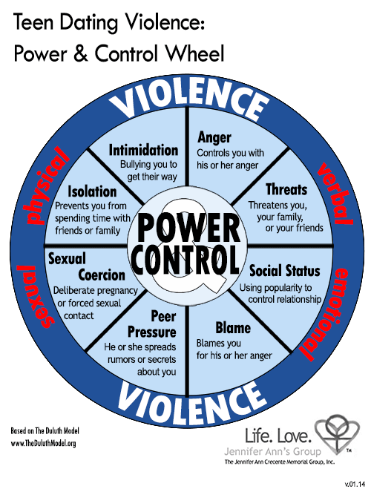
Tactics used by those who cause harm
How do they use power and control?
Notes:
Physical:
Physically inflicting pain
Emotional:
Extreme jealousy or insecurity
Explosive temper
Constant belittling or put-downs
Erratic mood swings
**After discussing tactics used by those who cause harm, show the video in the presentation**
Behavioral:
Checking cell phones, emails or social networks without permission
Isolation from family and friends
Making false accusations
Possessiveness
Telling someone what to do
Repeatedly pressuring someone to have sex
Sabotaging birth control, pressuring to become pregnant (Reproductive coercion).
Embarrassing or humiliating in front of friends or in public areas.
Constantly texting, requiring victim to always be reachable.
Demanding account for all time.
Posting sensitive pictures on social media.
Using peer pressure to control, such as, spreading rumors if partner refuses to have sex or telling malicious lies to peer group.
Coercive sexting
https://vimeo.com/233752039 Behind the post
Follow Up Questions:
What tactics did you recognize from a person causing harm?
Were there any warning signs Zoe was showing she was in trouble?
This video illustrates the way people talk about/present their relationships online versus in real life. How do you think perception plays into tactics a person causing harm use against the person experiencing harm?

Slide 12
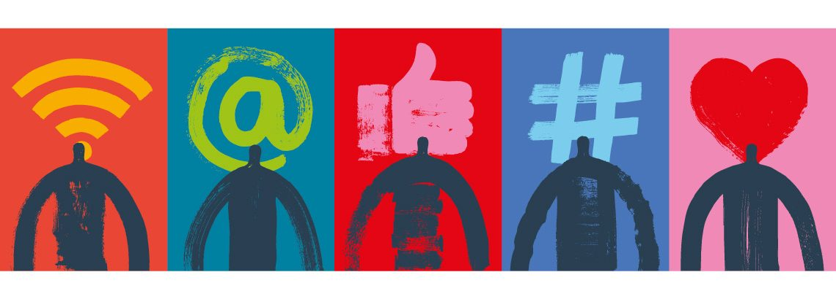
Guidance and Consideration A petitioner cannot be denied an order of protection because the petitioner or respondent is a minor. Minors 12 years or older, may receive eight 90-minute sessions of services without parental consent.
This Photo by Unknown Author is licensed under CC BY
Notes:
The following is information that will assist law enforcement agencies in increasing their accessibility to adolescents. These are taken out of the Protocols for Law Enforcement
1. IDVA and minor victims: The IDVA in several sections address the accessibility of the act to minors. The following sections have application to minors and their use of the IDVA:
a. The definition of family or household members includes those who have or have had a dating or engagement relationship. 750 ILCS 60/103(6) and 725 ILCS 5/112A-3(6). 8 https://beckysfund.org/resources/adolescent and young adult -dating-violence/ 13
b. A petitioner cannot be denied an order of protection because the petitioner or respondent is a minor. 750 ILCS 60/214(a) and 725 ILCS 5/112A-14(a).
c. A minor has the power to waive the privilege of their communication with a domestic violence advocate if the court feels that the minor can knowingly do so. 750 ILCS 60/227(e).
2. Orders of protection against minors: Orders of protection can be entered against minors. A minor is a family or household member as defined in the statute. Wright v. Wright, 221 Ill. App. 659, 662 (4th Dist. 1991). The act protects those that are being abused by family or household members. Id. 3. Service provider accessibility Law enforcement officers should work with domestic violence programs and rape crisis centers and refer victims to these programs. Minors 12 years or older, may receive eight 90-minute sessions of services without parental consent.

Slide 13
When a disclosure occurs . . .
Address
Where to seek support
Confidentiality
Legal Consideration
Self-Advocacy
Avoid
Judgement
Assumptions
Belief Systems
“Rescue Mentality”
Notes:
Do’s: (Address)
• Encourage and support their choice to get help.
• Mirror the adolescent’s choice of words, tone and body language.
• Be honest about your ability to keep information confidential.
• Be direct about your legal responsibilities, especially regarding parental involvement.
• Help the adolescent be in control and make their own decisions as much as possible.
• Provide information on local resources and encourage the adolescent to seek help.
Don’t: (Avoid)
• Don’t be judgmental about the adolescent’s relationship or choices.
• Don’t show shock or disapproval if the adolescent tells you about his/her sexual activities.
• Don’t assume that abuse in a new or causal relationship is not serious.
• Don’t assume that the abusive partner is also an adolescent.
• Don’t share a youth’s private information unnecessarily.

Slide 14
Documenting Tech Abuse
Notes:
Use handout here from protocols LE/P Chapter 5 pg. 12
If you’re concerned that your partner may be monitoring your phone, consider buying a pay-as-you-go phone to keep in a safe place for private usage.
Keep a password on your phone (updating it regularly) and consider taking it into a cell phone service center to check for spyware.
Consider opening a new email account that your partner doesn’t know about on a safe computer and use that email for safety planning (including documenting abuse) and sensitive communications.
Be sure to keep everything you document somewhere that your partner can’t access. It can help to create a secret email address specifically for the purpose of documenting abuse with a password only you know, or to keep everything hidden in a place they never go.
*** Optional videos:
https://www.newswest9.com/article/news/local/impacts-of-technology-on-domestic-violence/513-22c2ddae-3851-4343-8270-97057a5f04ea
KSAT News: https://www.ksat.com/news/local/2021/02/23/new-social-media-campaign-lays-out-red-flags-in-teen-dating-violence/

Slide 15
Safety Planning
Alert authorities as needed – law enforcement, school administration, etc.
Consider changing – locks, phone numbers, travel routes, passwords, etc.
Block certain telephone numbers
Employ the buddy system
Tell other trusted adults to keep a watchful eye
Request an Order of Protection if needed
Seek out resources and support groups in area
Notes:
Optional Safety planning handout-Adolescent Young Adult-Safety Planning

Slide 16
Activity 4 : Dana Fure’s Story
Notes:
See Attached Activity #4
Use handout or link for virtual story

Slide 17
Resources
DV Protocol
Loveisrespect.org
Employee Assistance Program
The American Bar
One Love Foundation
Breakthecycle.org
NNEDV's Safety Net Teens and Technology
https://www.techsafety.org/survivor-toolkit/teens-and-technology
Notes:
Resources:
1* - DV Protocol
2* - https://www.americanbar.org/groups/public_interest/child_law/resources/child_law_practiceonline/child_law_practice/vol_32/october-2013/lgbt-youth-face-higher-rate-of-dating-abuse/#:~:text=Of%20the%20LGB%20respondents%3A,percent%20of%20heterosexual%20youth%3B%20and
3* - Loveisrespect.org
4* - https://www.loveisrespect.org/understanding-adolescent and young adult -dating-violence-and-sexual-assault/
5* - http://eap.partners.org/WorkLife/Domestic_Abuse/What_Parents_need_to_know/What_parents_need_to_know.asp
6* http://eap.partners.org/WorkLife/Domestic_Abuse/What_Parents_need_to_know/What_parents_need_to_know.asp?nav=leftnavigation19
7* http://eap.partners.org/WorkLife/Domestic_Abuse/What_Parents_need_to_know/What_parents_need_to_know.asp
8* DV Protocol
9* DV Protocol
https://www.joinonelove.org/videos/
Break the cycle - https://www.breakthecyle.org/blog/same-violence-different-challenges-relationships-and-dating-abuse-lgbtq-community

Slide 18

Questions

Slide 19
Videos
https://www.cbsnews.com/video/teen-dating-violence-a-survivor-shares-her-story/#x
https://www.youtube.com/watch?v=8wem8wzU5zw
https://www.youtube.com/watch?v=He1pu4VwKdM
https://www.youtube.com/watch?v=4JYyHa03x-U
This project was supported by Grant No. 2019-WE-AX-0009 awarded by the Office on Violence Against Women, U.S. Department of Justice. The opinions, findings, conclusions, and recommendations expressed in this publication/program/exhibition are those of the author(s) and do not necessarily reflect the views of the Department of Justice, Office on Violence Against Women.

